Slide 1
Group Id: 13
Guide: Prof. Rachana R. Chhajed
By:
Komal Parmar (BE IX - 43145)
Manvi Pandya (BE X - 43233)
Neha Jaju (BE X - 43222)

Slide 2
Introduction
There are many methods available through which deaf and dumb people can communicate, still there are many difficulties that these people face while communicating with normal people. The problem is not only deaf and dumb people who are unable to hear or speak but lack of awareness of society towards them. Most of the normal people don’t have any knowledge of sign language and there are more than 300 sign languages available which makes it more difficult for them to communicate. There are various facilities available for normal people to interact like video calling and messaging applications which is why people with such disabilities may become introverts as they lack social interaction leads to frustration and depression.
The proposed system is an android application for dumb, deaf and normal people with functionalities of messaging and video calling by converting hand gestures to text and speech and vice versa using a convolutional neural network model which works on Indian Sign Language (ISL) dataset based on vision approach.

Slide 3
Abstract
According to the World Health Organization (WHO) over 5% of the world's population have impaired hearing and speaking loss. It is very difficult for specially abled people to communicate. This paper proposes a system to overcome these barriers and allow everyone to interact with each other irrespective of their disabilities and facilitates specially abled and normal people to communicate with each other through messaging and video calling.

Slide 4
Literature Survey
Title | Publication | Advantages | Disadvantages
Android based American Sign Language Recognition System with Skin Segmentation and SVM | 9th ICCCNT, IISC, Bengaluru, India 2018. | The accuracy obtained by this system is 89.54%. It is a mobile based application which is easy to carry rather than using a laptop or desktop. This application requires less memory in the phone. | The accuracy varies with complex backgrounds. It requires proper illumination for more accuracy. The translation of gestures involving hand movement is not accurate. This system can only convert sign language into text but vice versa is not possible.

Slide 5
Literature Survey
Title | Publication | Advantages | Disadvantages
Hand Gesture Recognization And Voice Conversion System For Dumb People | 5th International Conference on Advanced Computing & Communication Systems (ICACCS), 2019. | Using sensors is more accurate than using cameras. Simple coding language is used to make it less complicated. | Not accurate in all directions. Small variations are not determined. Hardware is used (flex sensor, ADC converter, ADC0804, microcontroller such as PIC, Arduino and speaker)
Real-time Conversion of Sign Language to Text and Speech | Proceedings of the Second International Conference on Inventive Research in Computing Applications (ICIRCA), 2020. | 98.82% accuracy is achieved using this system. It is an android application so the only requirement is a smartphone with active internet. The system provides functionality of adding new alphabets, removing stored alphabets and conversion of text to speech. | This system can only convert sign language into text but vice versa is not possible.

Slide 6
Literature Survey
Title | Publication | Advantages | Disadvantages
Real-time Sign Language Recognition Based On Video Stream | Proceedings of the 39th Chinese Control Conference, Shenyang, China, July 27-29, 2020. | When it comes to recognizing large sign language datasets, there will be great challenges which are overcome by using 3D-CNN. Motion and head recognition is also considered with hand gestures which makes the model more accurate. Accuracy is improved by reducing the number of frames using Optical Flow. | Using Optical Flow makes pre-processing very complex thus making the overall model slow. It is only for one particular language and there is no option for customization of the user. User needs to do a complete action continuously and for the next word he has to wait because 1 frame is recorded for 5 sec

Slide 7
Methodology
Dataset:
The dataset used is the ISL dataset, which contains about 87,500 images for every alphabet and number of the English vocabulary. Every user can maintain their separate customized dataset which will allow the user to form sentences in a very simple fashion.
Pre-processing:
Convert color images to grayscale to reduce computation complexity
Standardize images: In CNN it is necessary to resize the images in your dataset to a unified dimension.
Object Detection:
Object detection technique is to determine where objects are located in a given image called as object localisation and which category each object belongs to, that is called as object classification. In this project, the 3 of the following object detection techniques have been chosen:
YOLO v3 (You Only Look Once)
YOLO v4 (You Only Look Once)
Faster RCNN (Region-based Convolutional Neural Network)

Slide 8
Methodology
Image Classification:
To perform image classification using deep computer vision with convolutional neural network is one of the best approach. The goal of our convolutional neural networks is to classify and detect images or specific objects from within the image. The following are some of the CNN architectures:
Residual Network or ResNet152 v2
XceptionNet
InceptionNet
Integration of object detection and image classification
Conversion of model to .tflite
Speech to Text:
To convert speech to text speech_to_text plugin will be used.

Slide 9
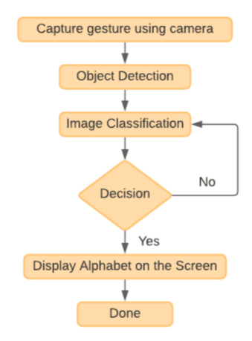
Detailed Design
Step 1: Image from the live camera stream will be reshaped and resolution will be reduced.
Step 2: The processed image will be the input to yolov4 which further detects the hand and creates a bounding box.
Step 3: Using the bounding box coordinates the image will be cropped.
Step 4: Cropped image will then be given as input to ResNet for classifying the image.
Step 5: The classes will be mapped to their labels.
Step 6: The labels will be displayed on the screen.

Slide 10
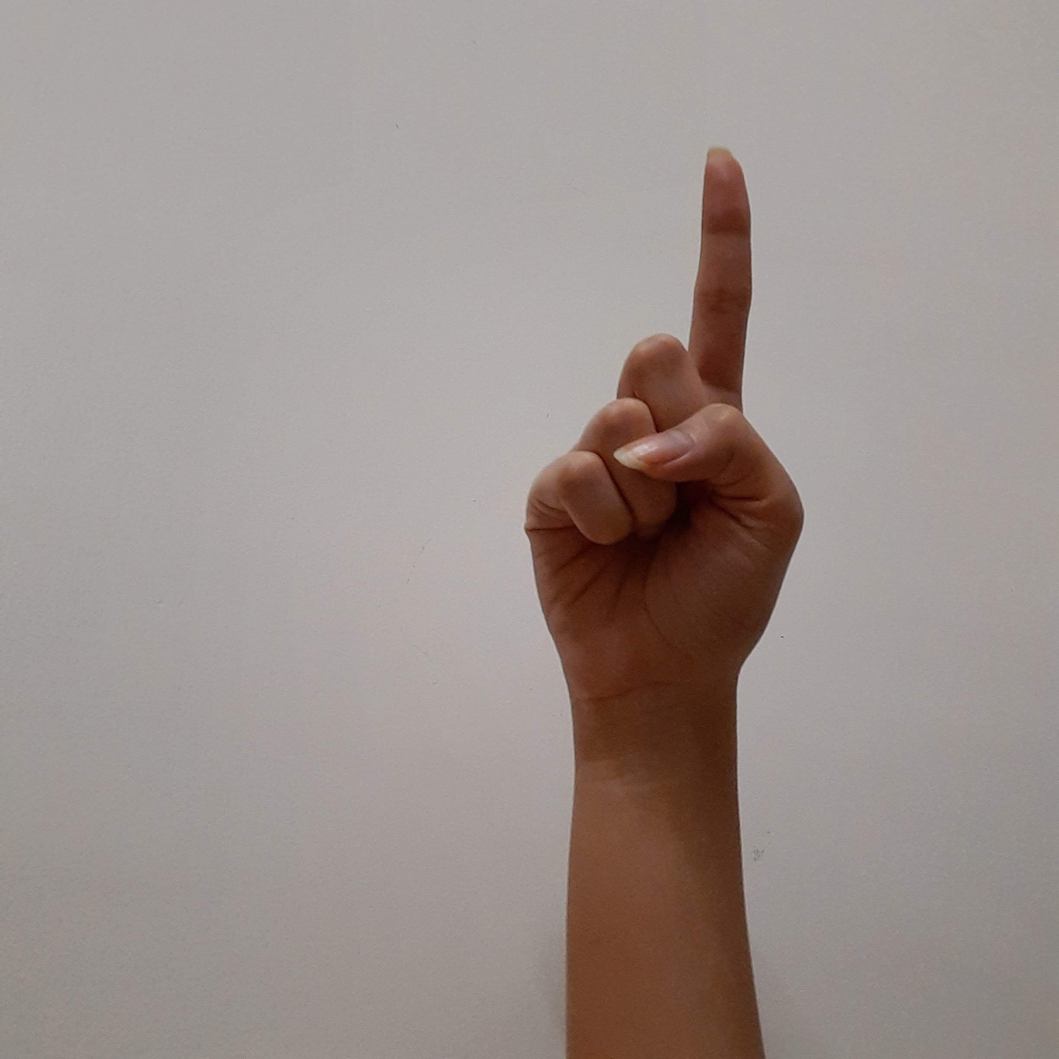
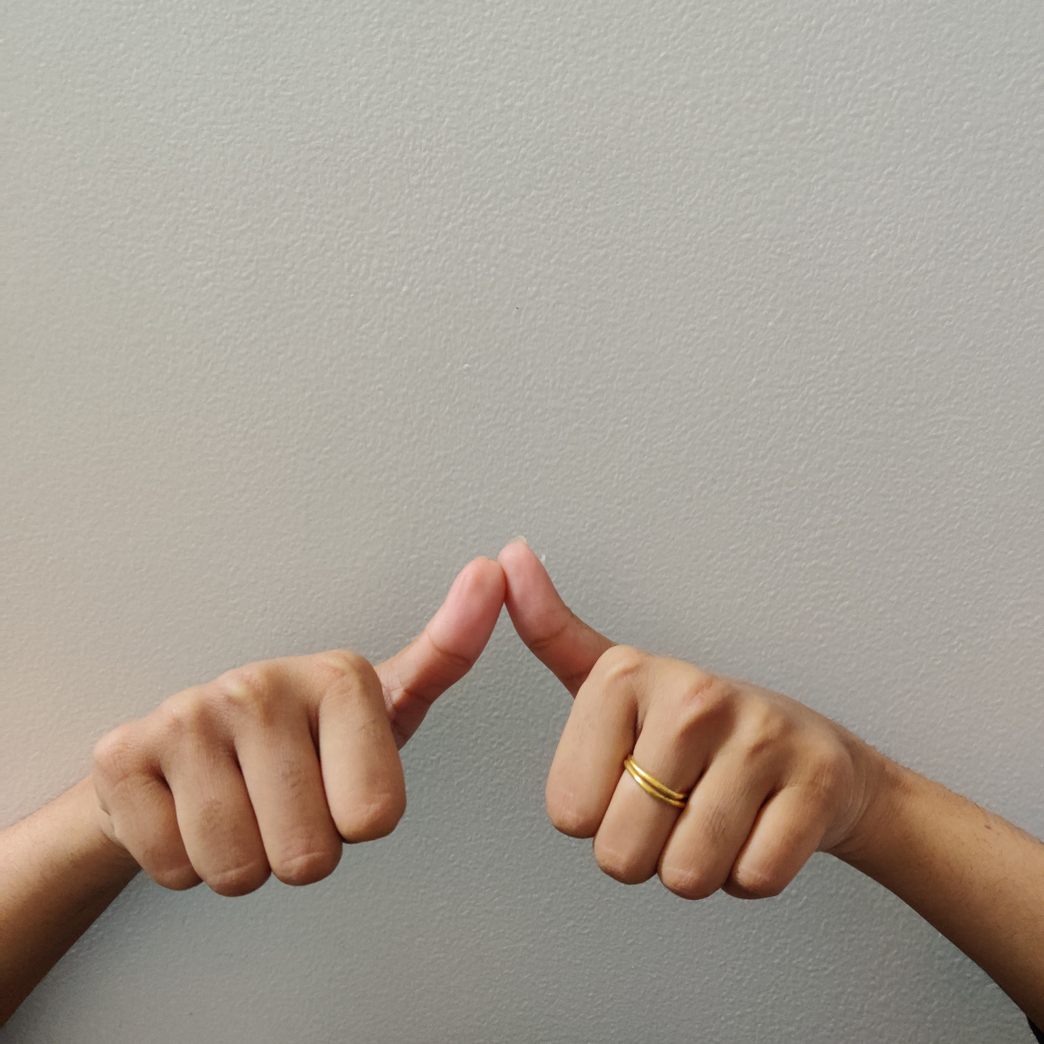
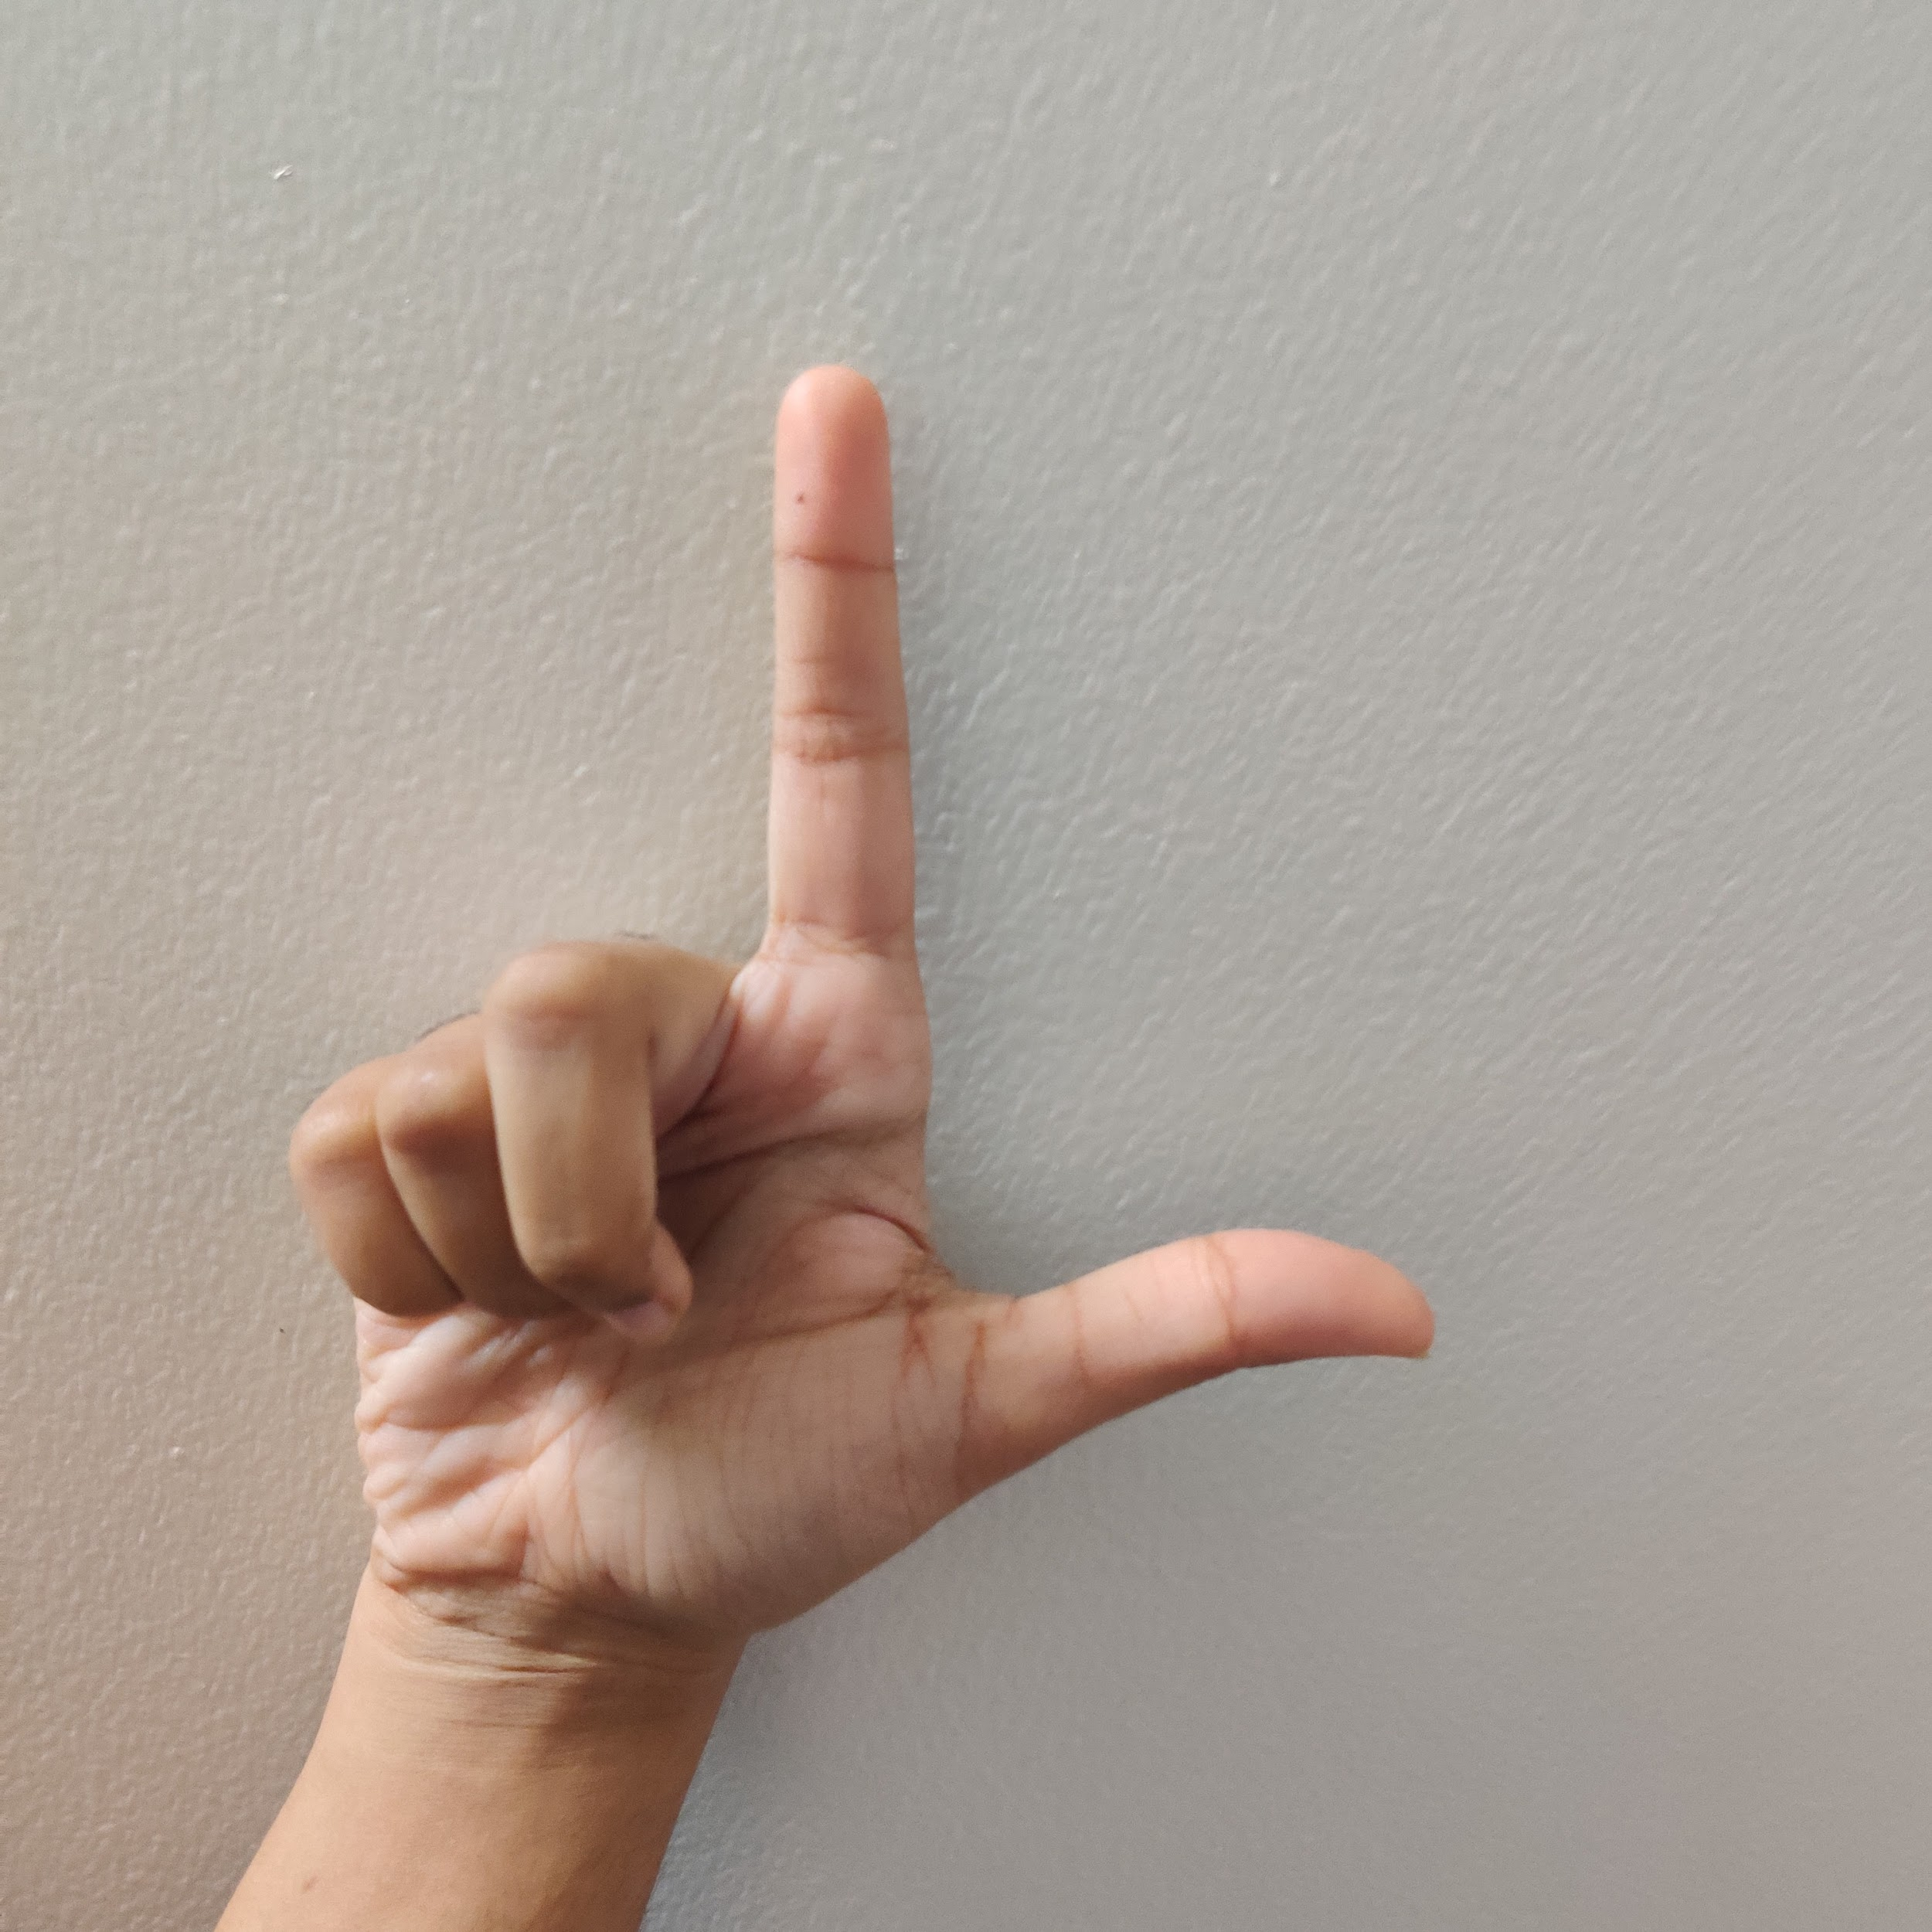
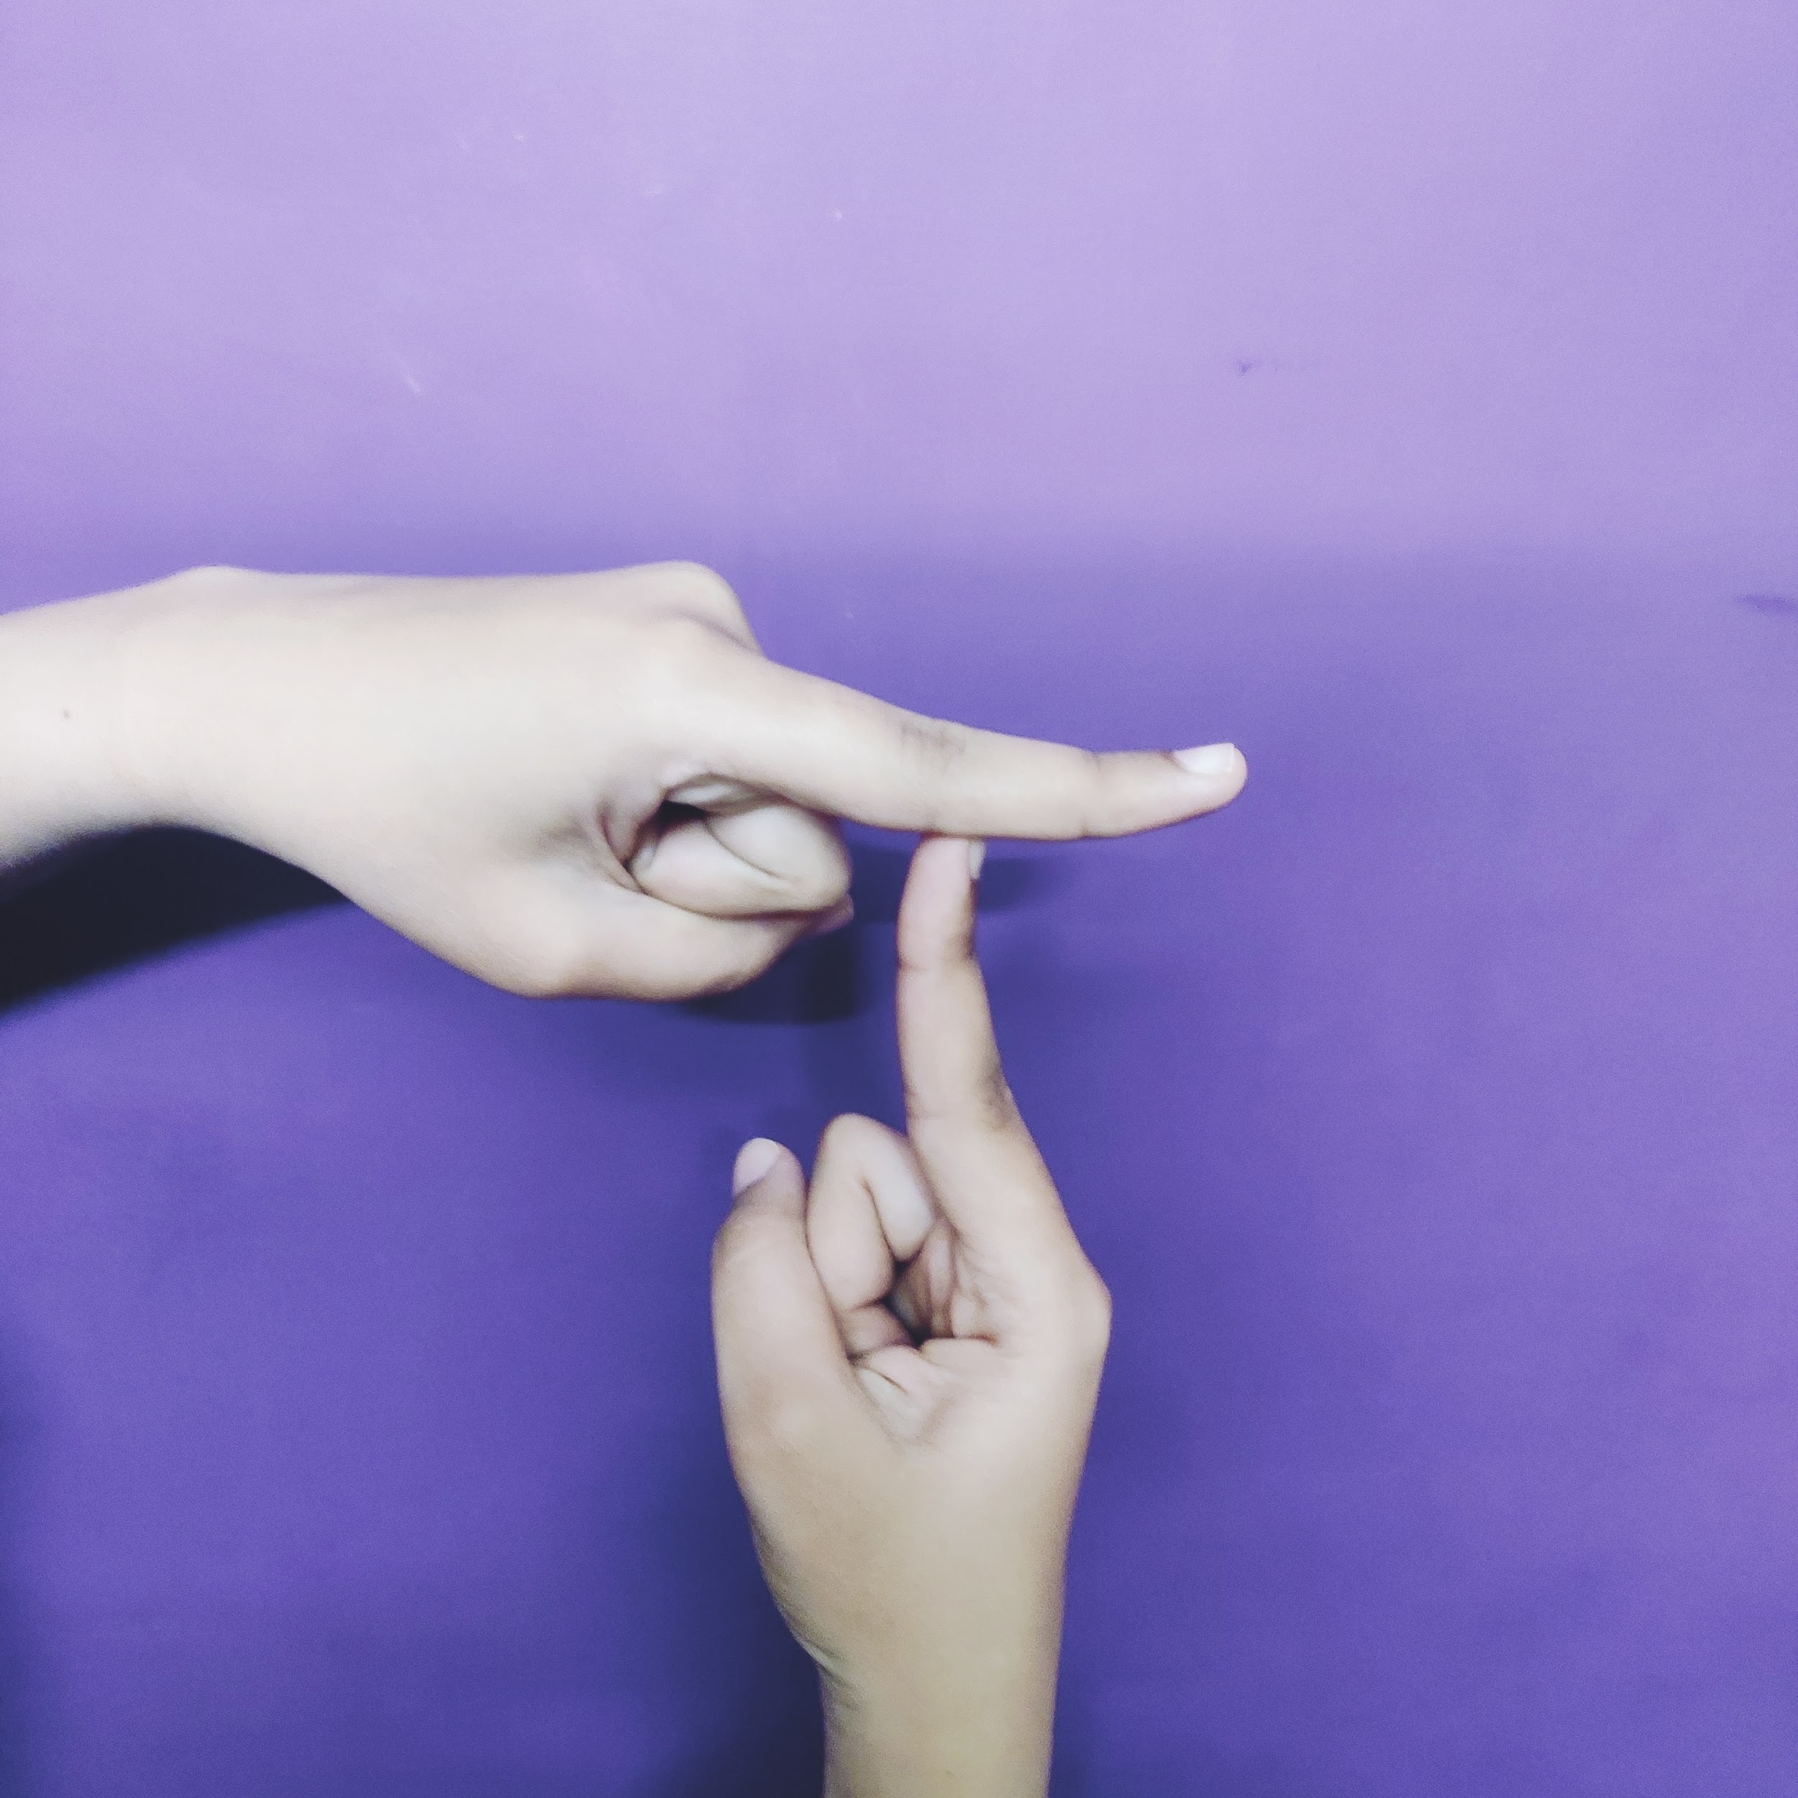
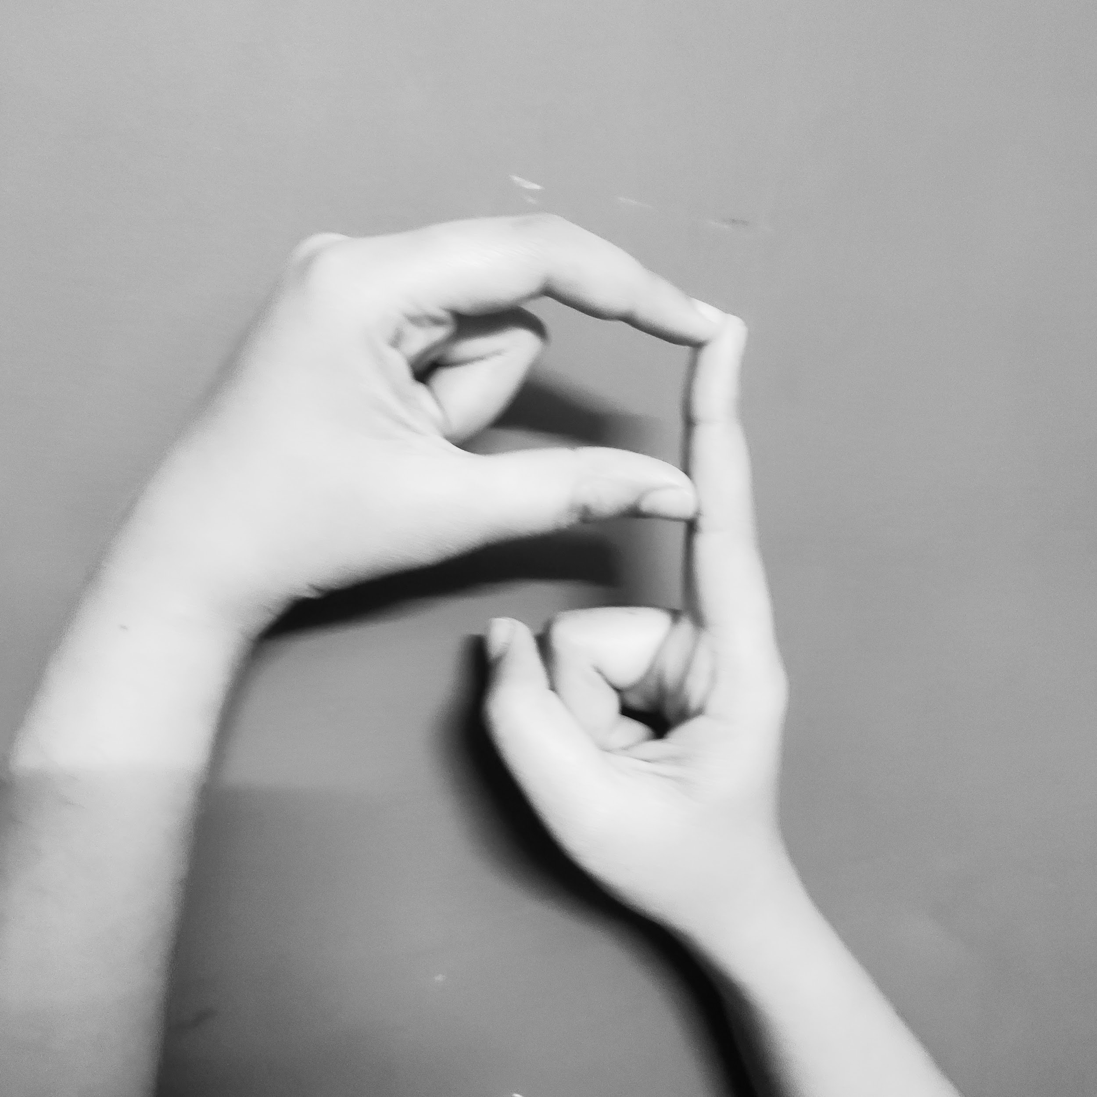
Dataset
An ISL Dataset has been created by our team which contains 2500 images of each alphabets from A-Z and numbers from 1-9 making it a total of almost 87,500 images.

Slide 11
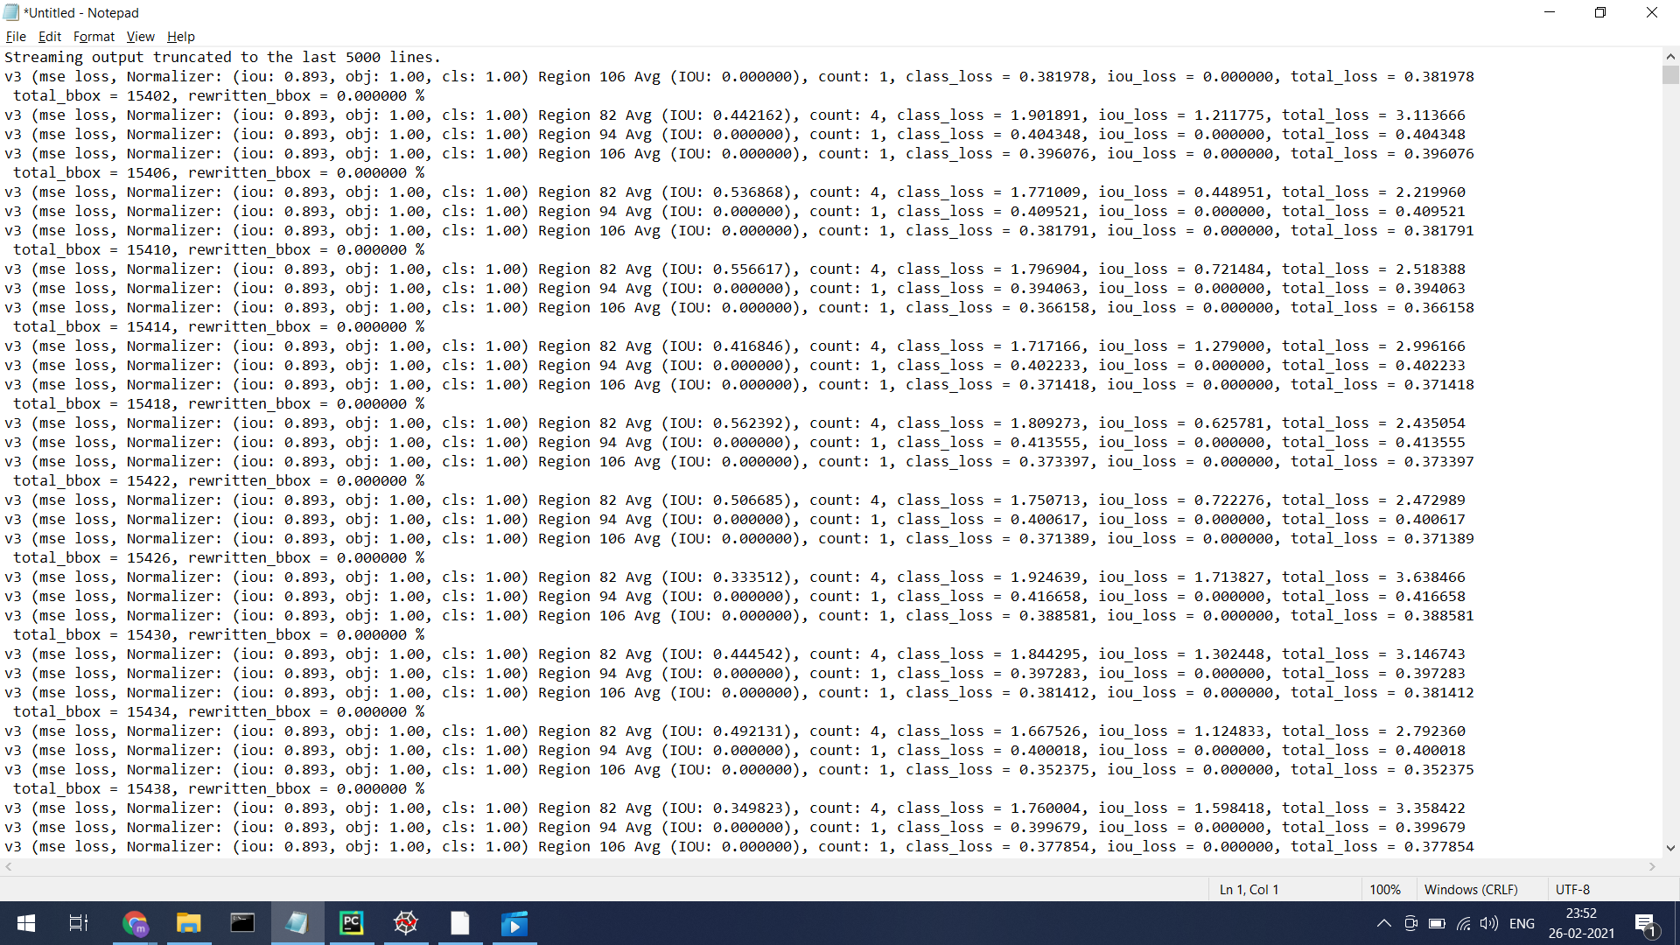
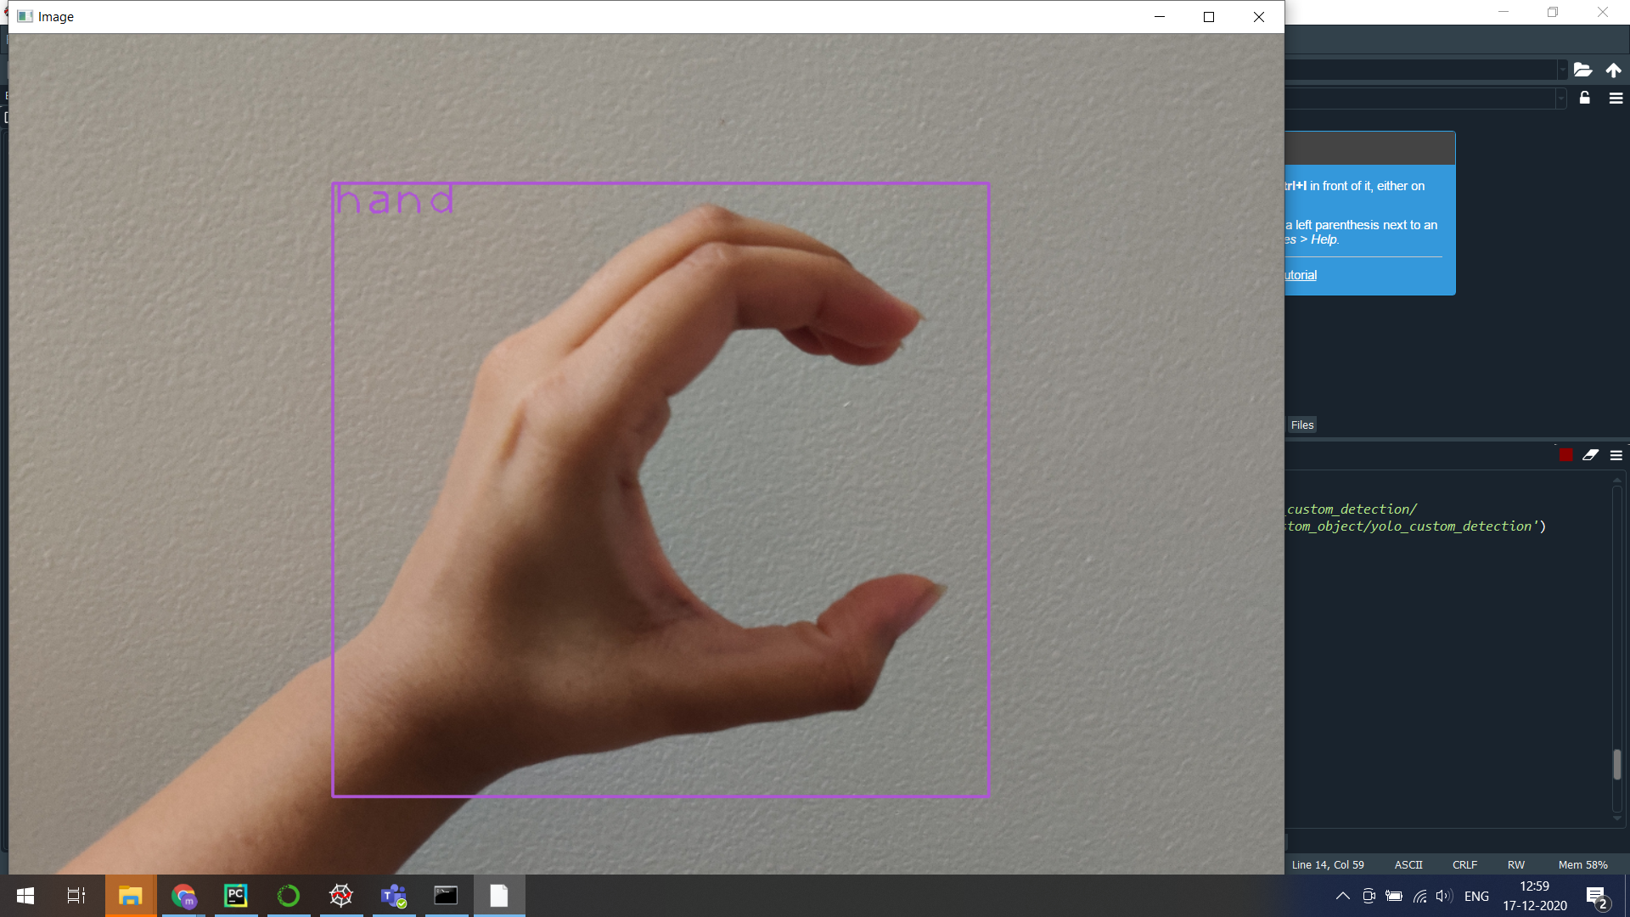
Object Detection
YOLO v3

Slide 12
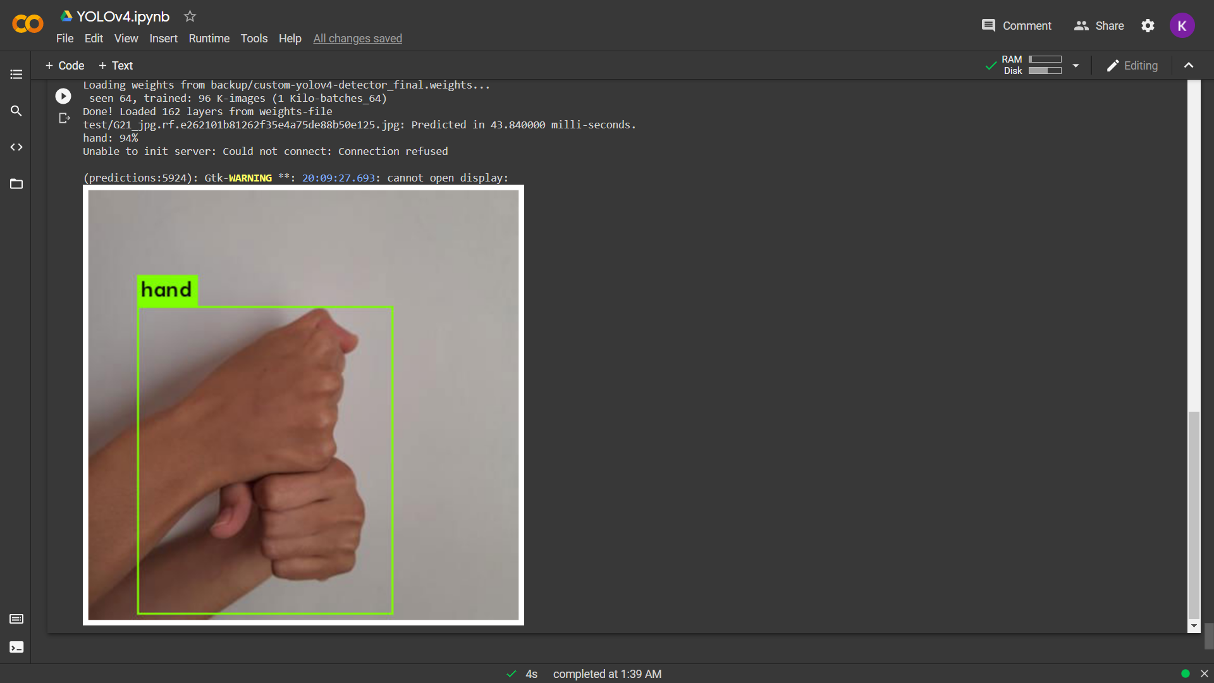
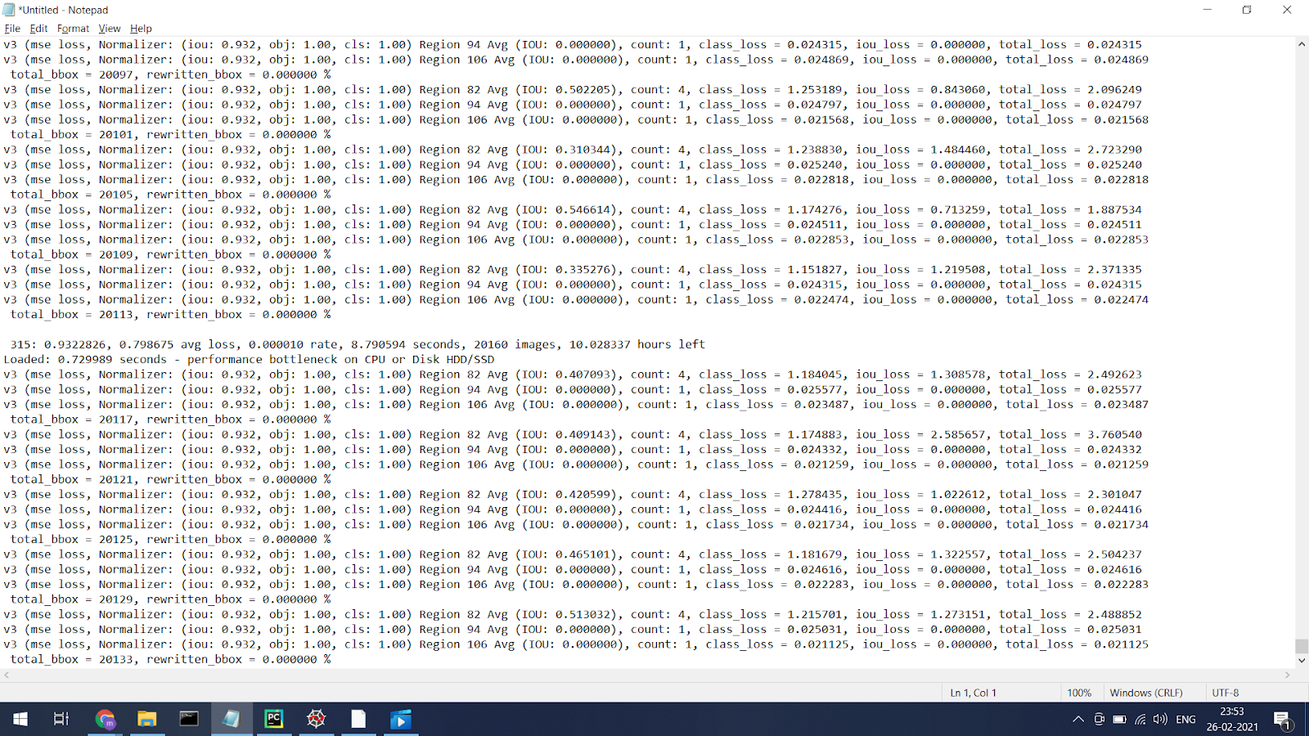
Object Detection
YOLO v4

Slide 13
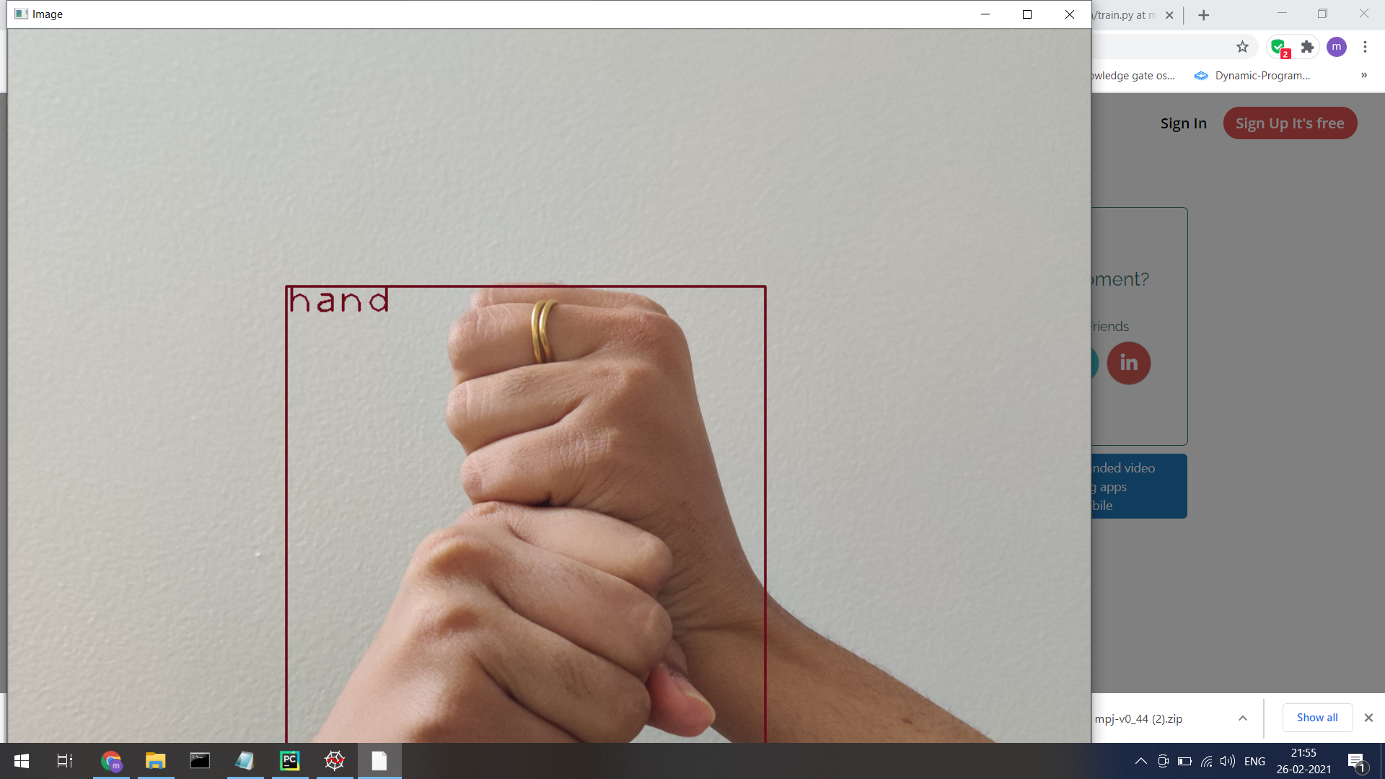
Object Detection
Faster RCNN

Slide 14
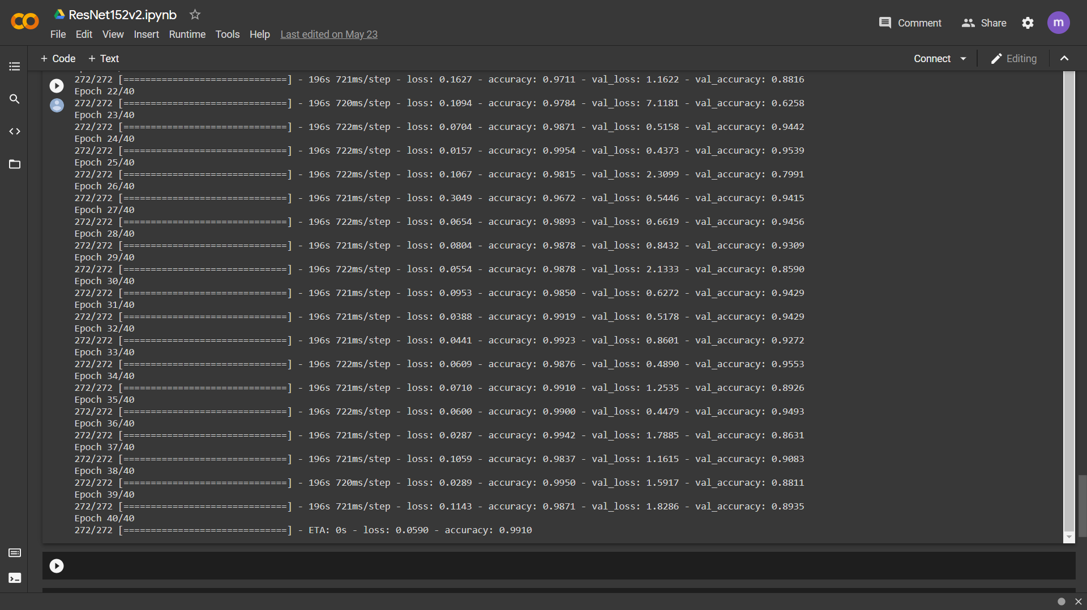
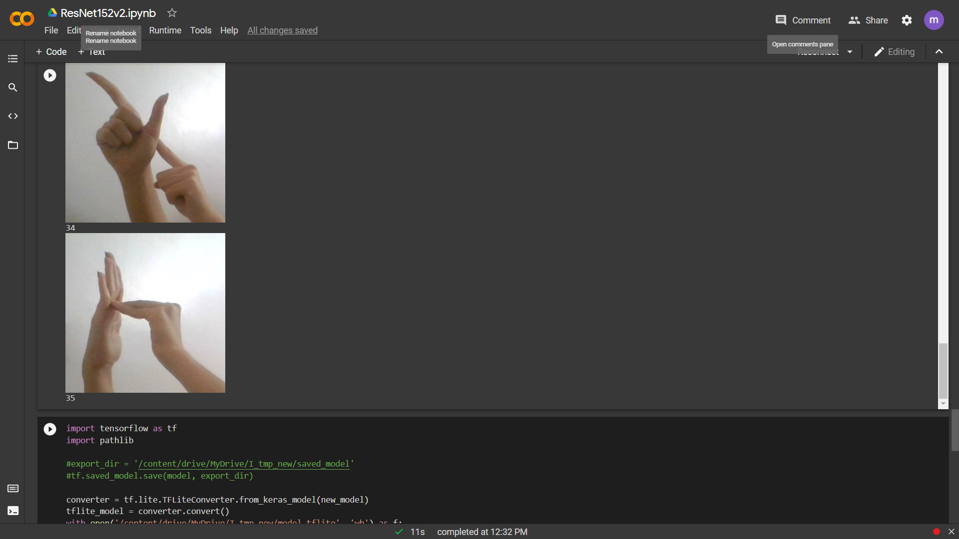
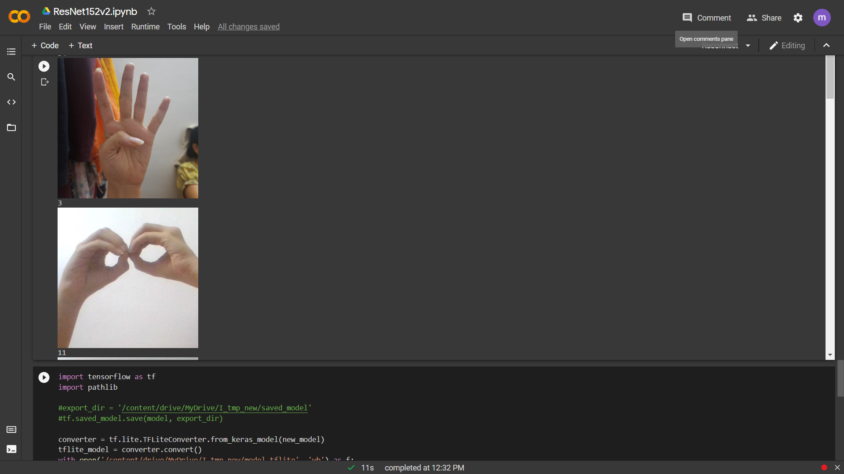
Image Classification
ResNet152 v2 (Residual Network)

Slide 15
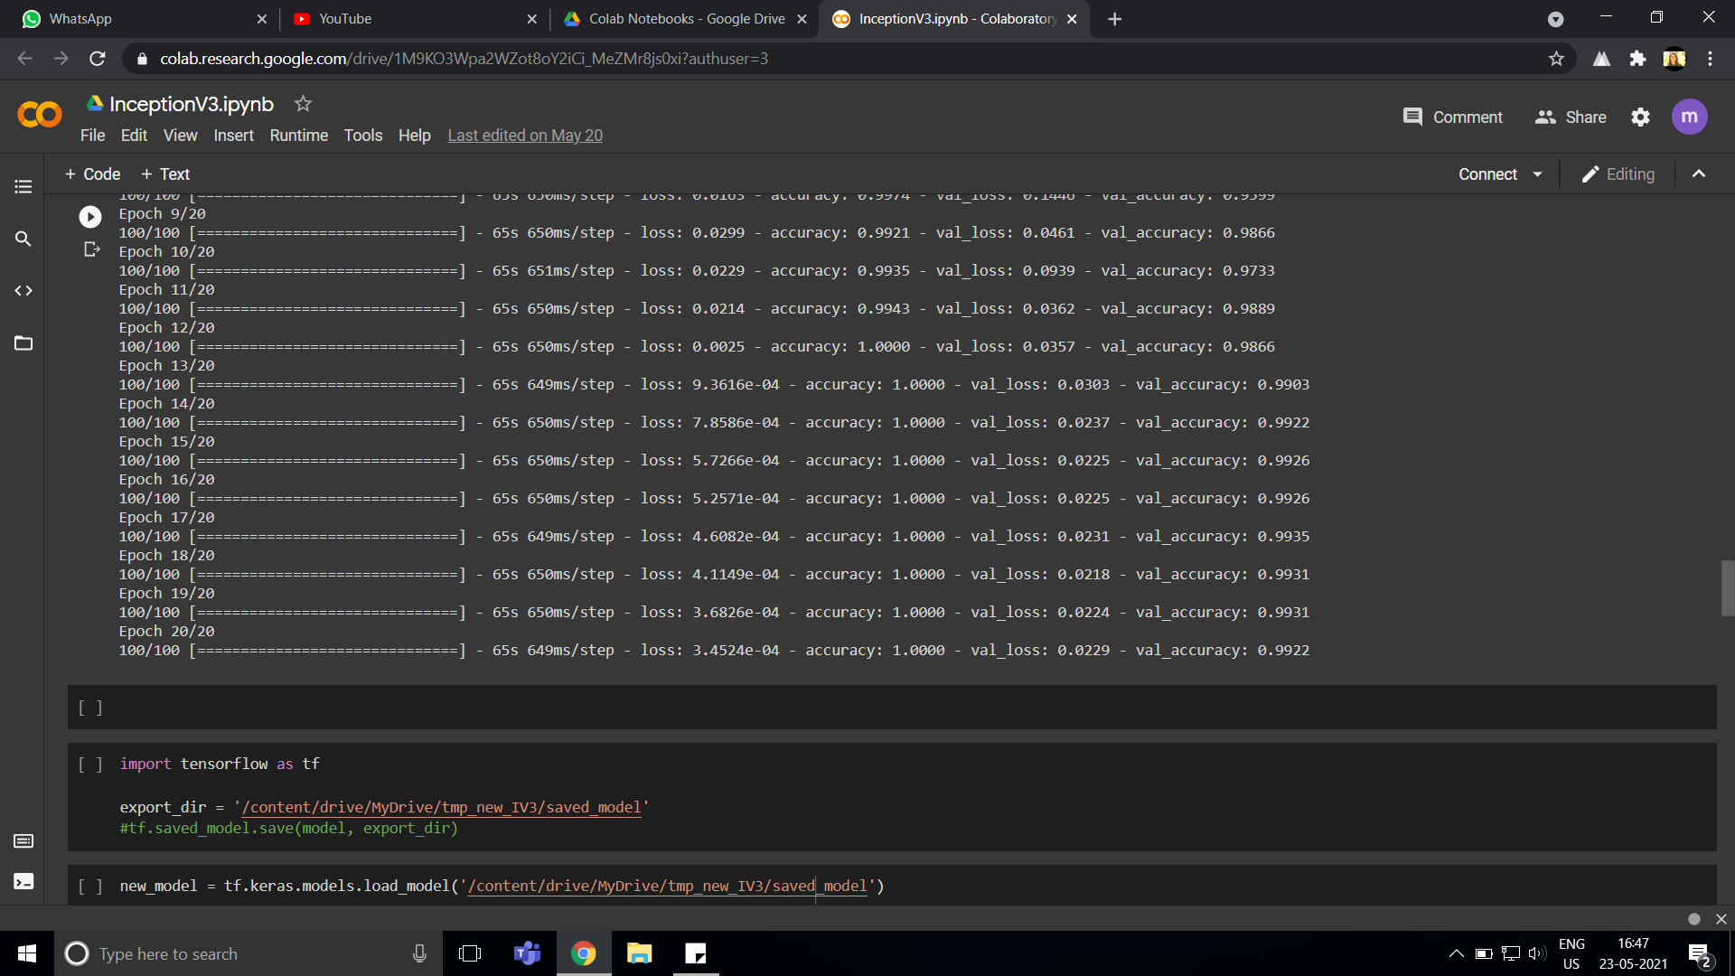
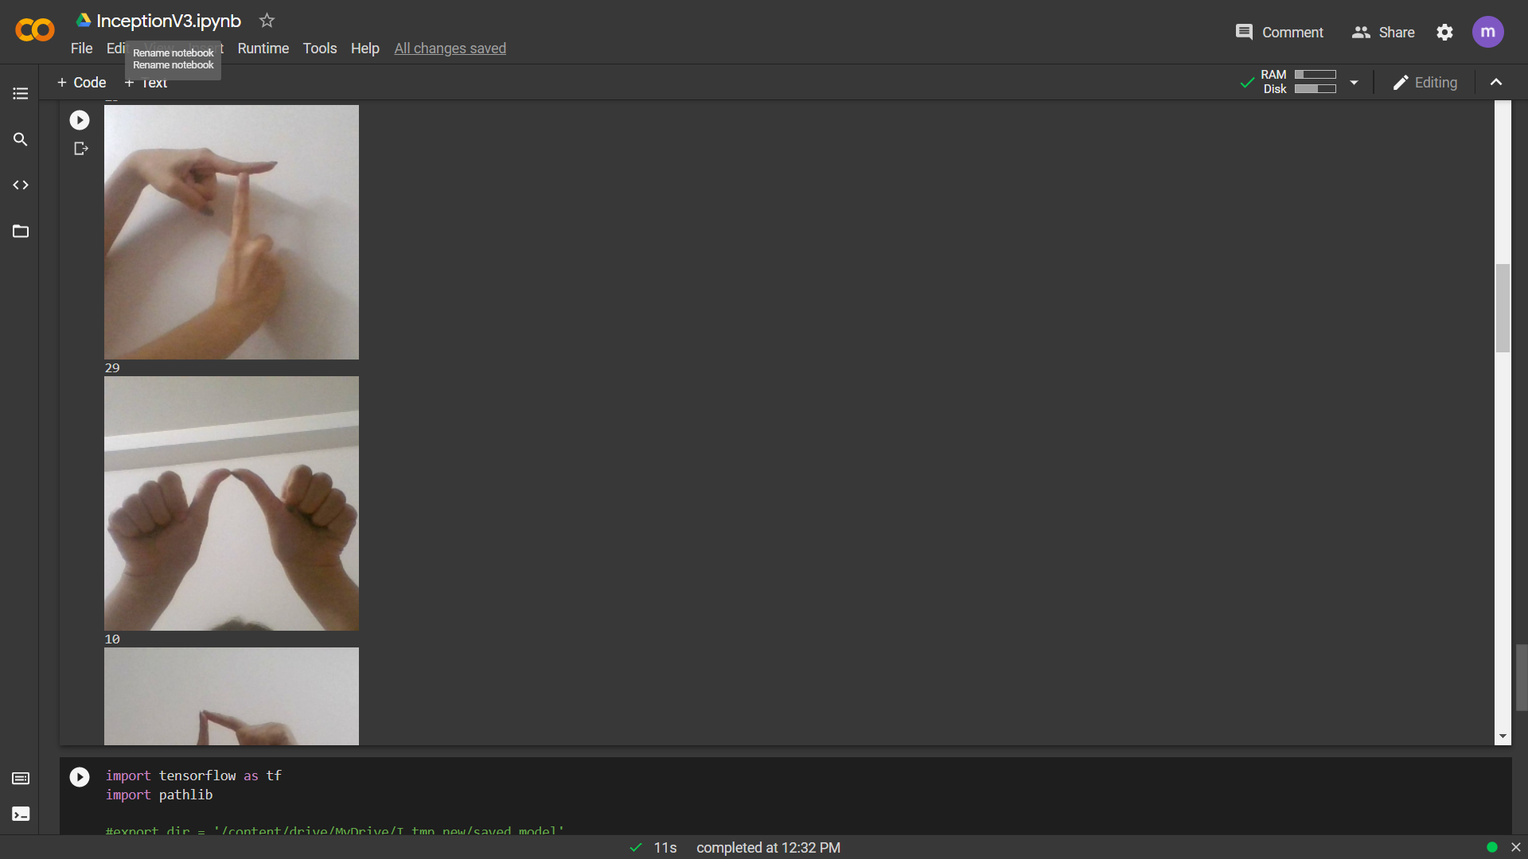
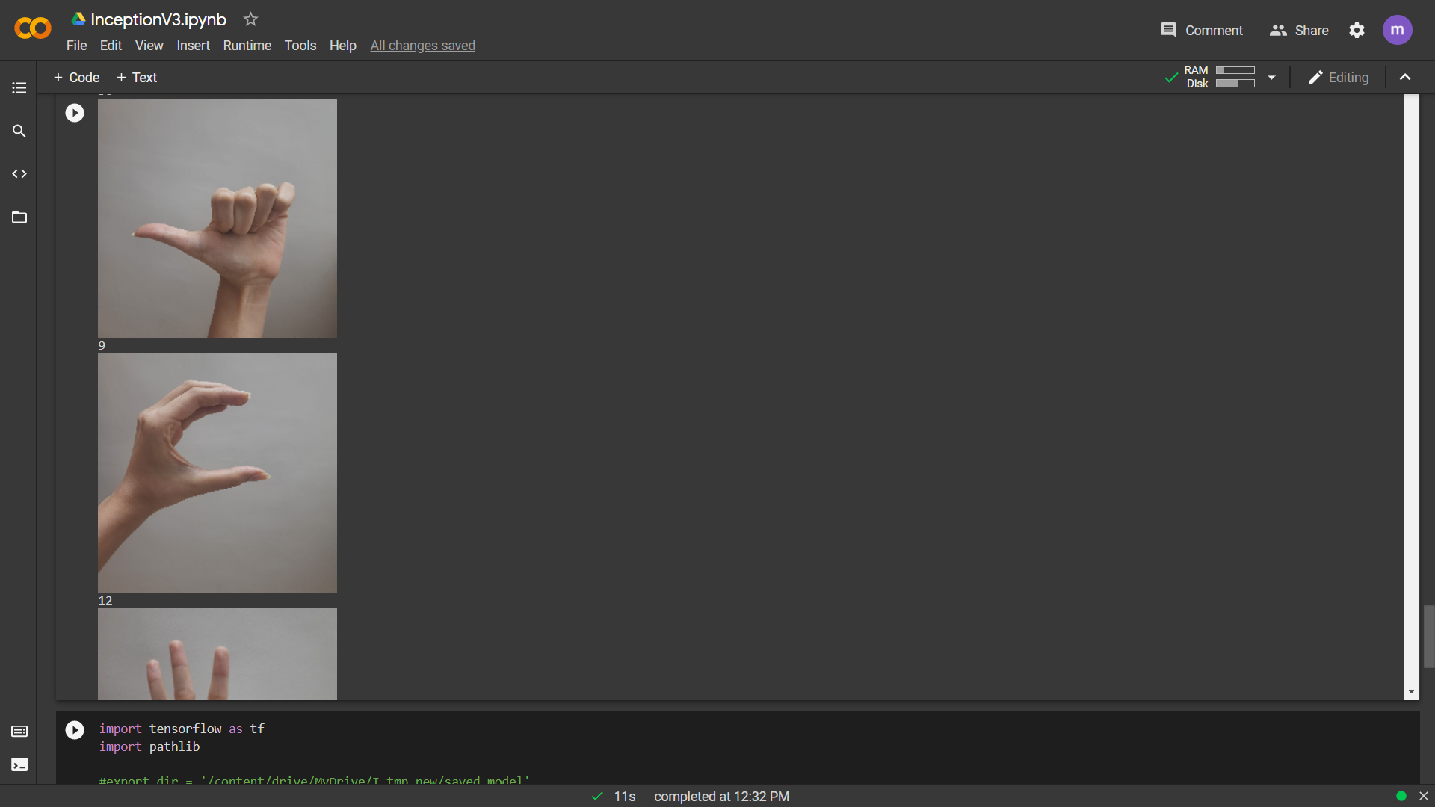
Image Classification
InceptionNet

Slide 16
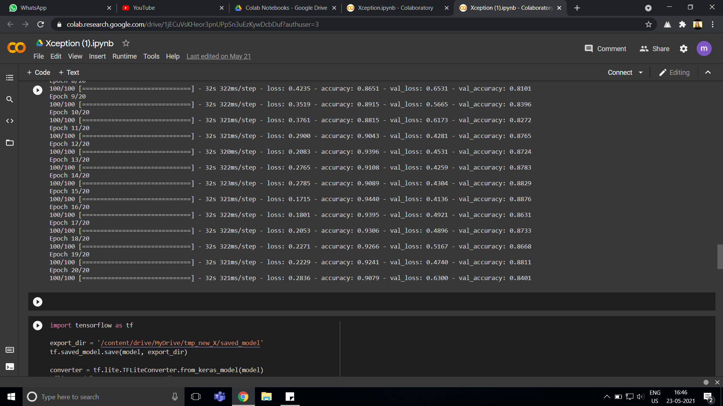
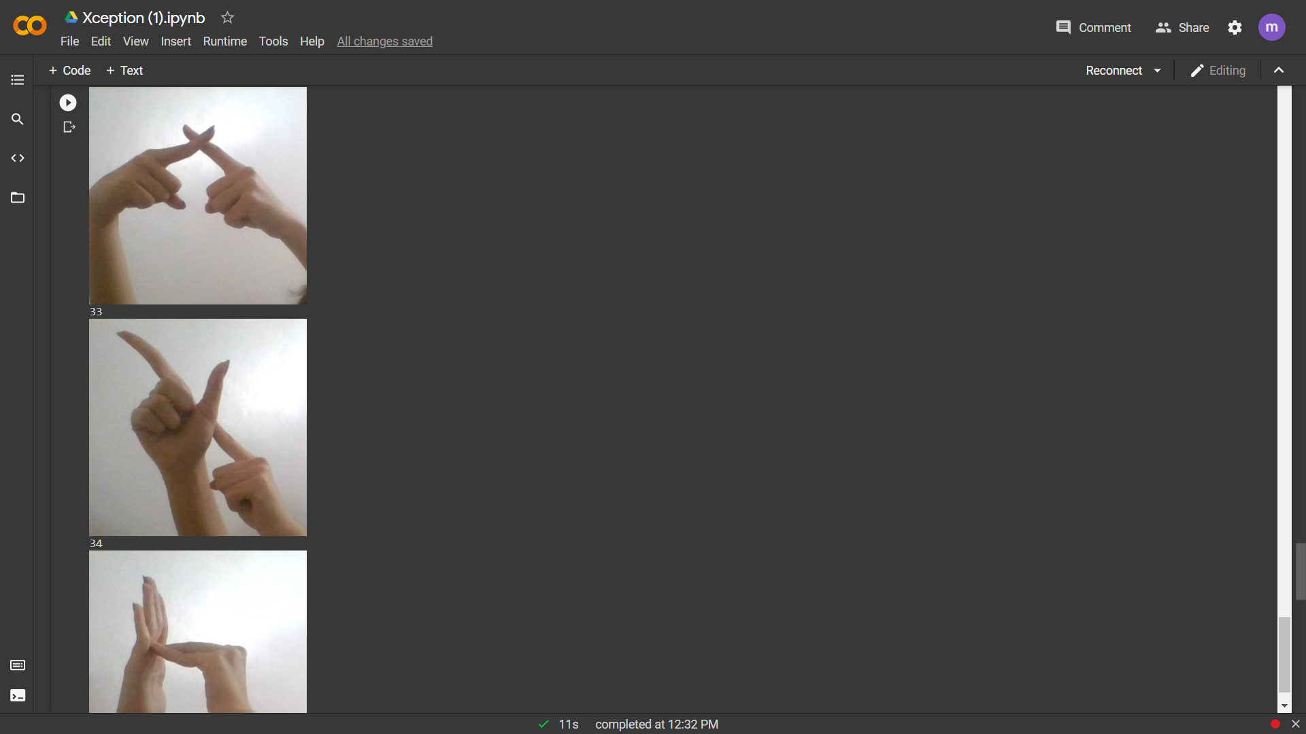
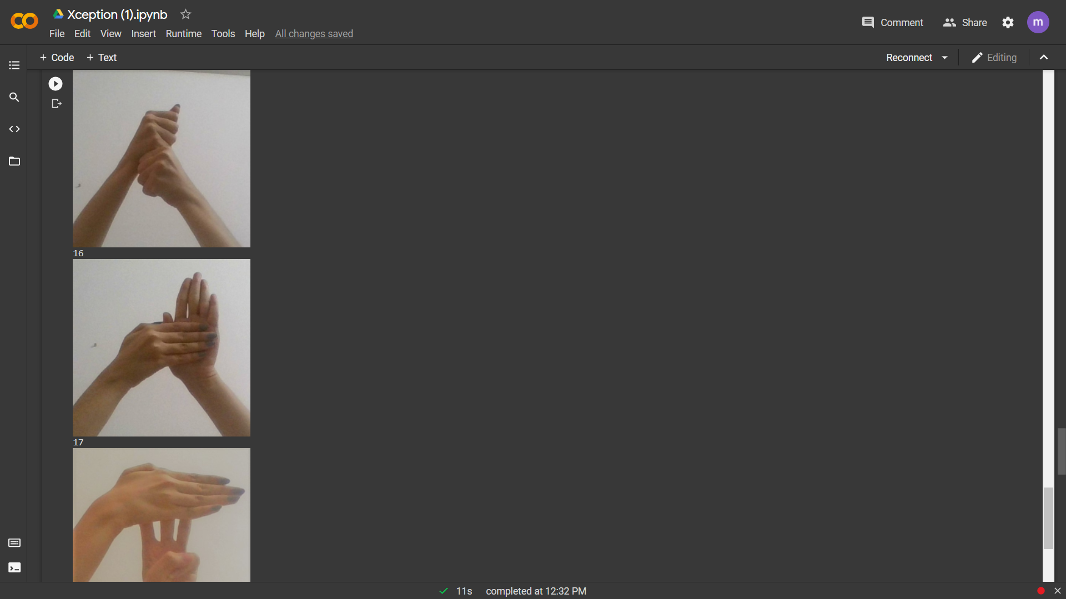
Image Classification
XceptionNet

Slide 17
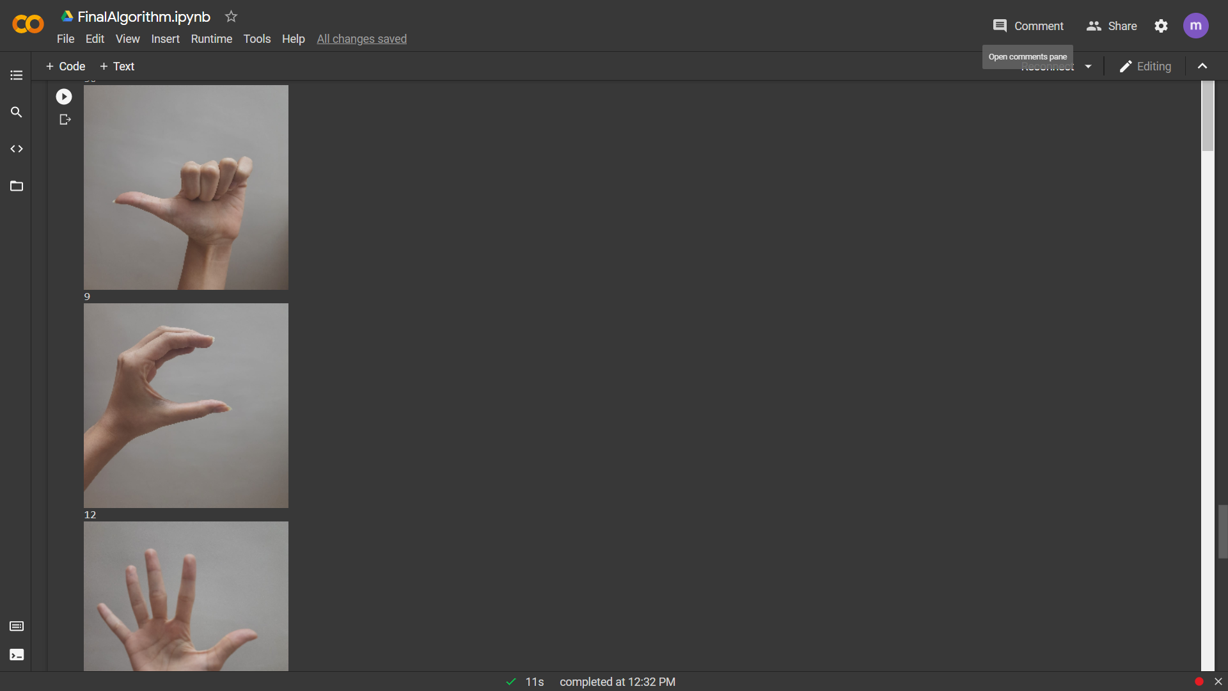
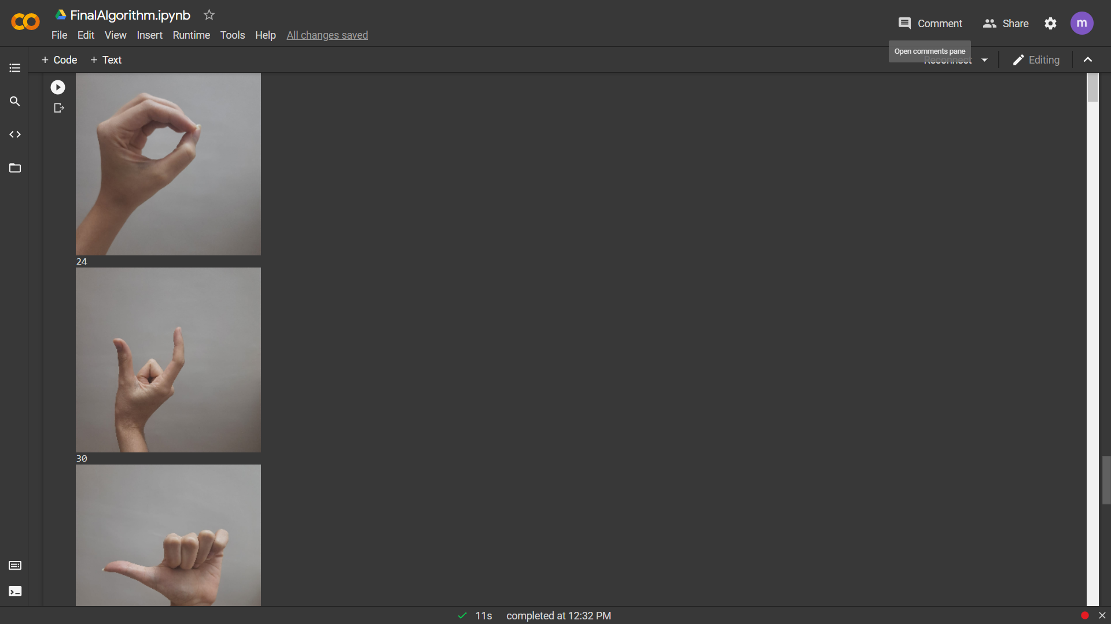
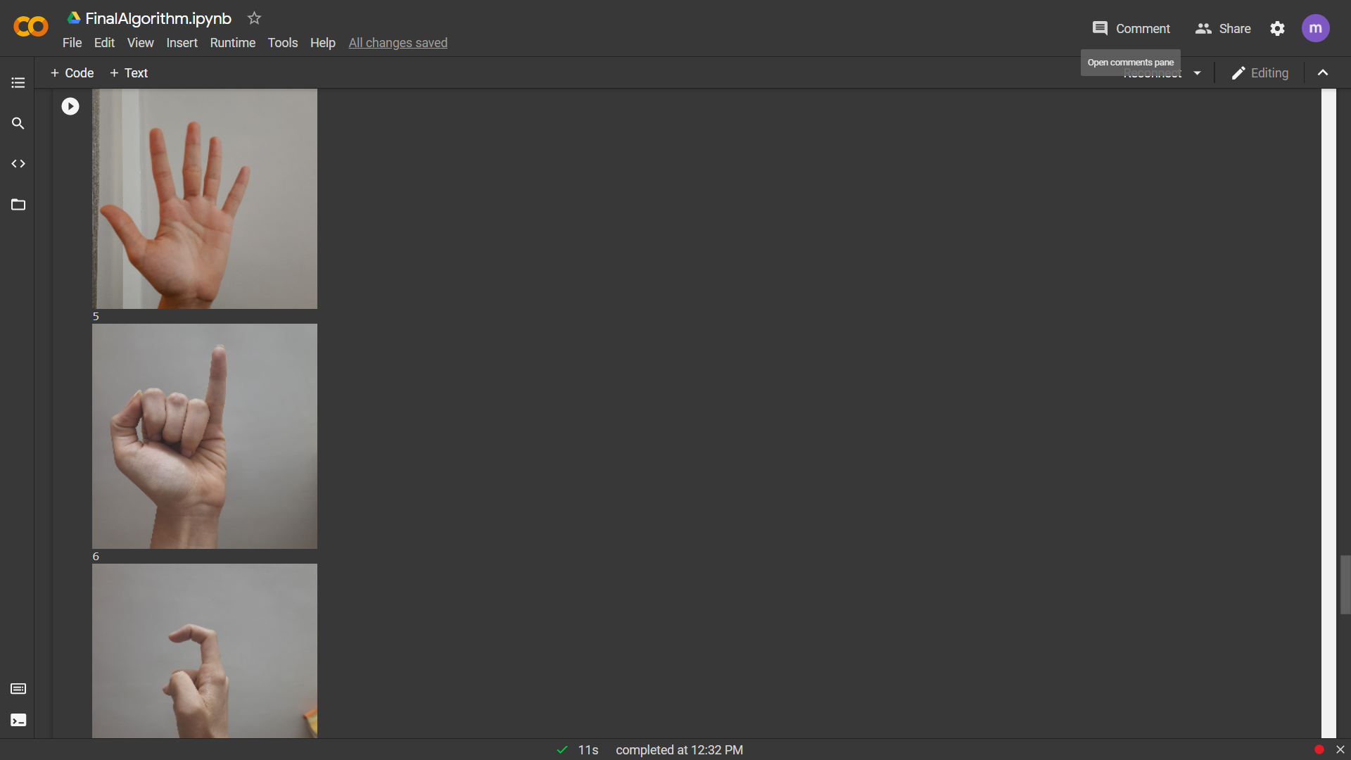
Final Algorithm (YOLO v4 with ResNet152 v2)

Slide 18
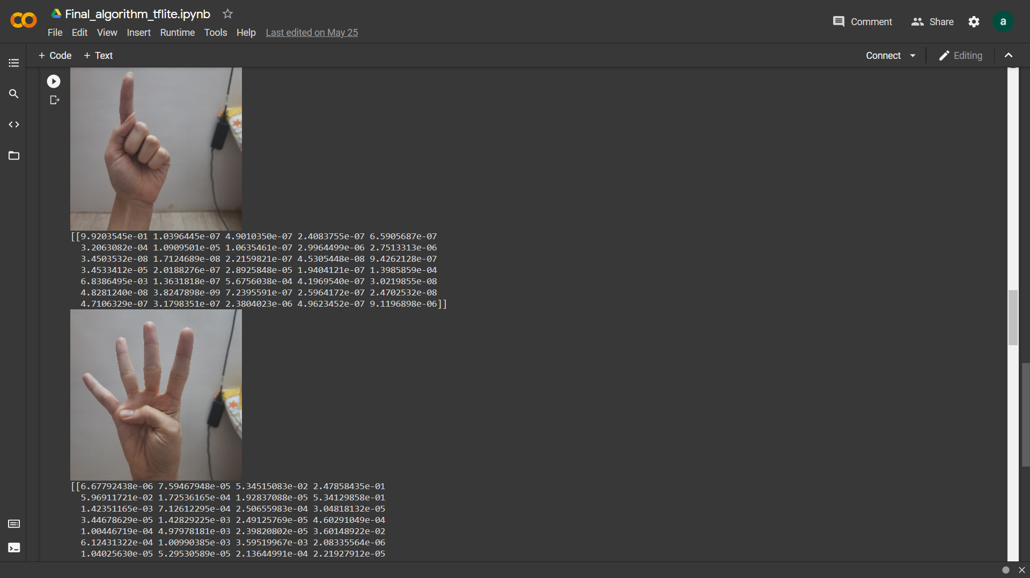
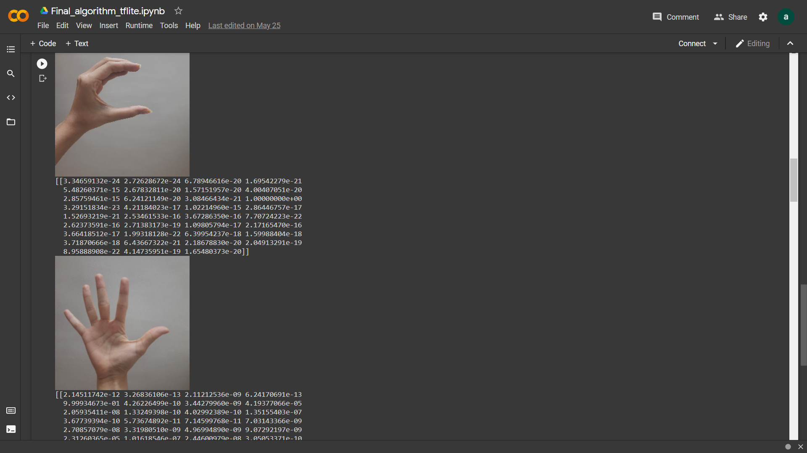
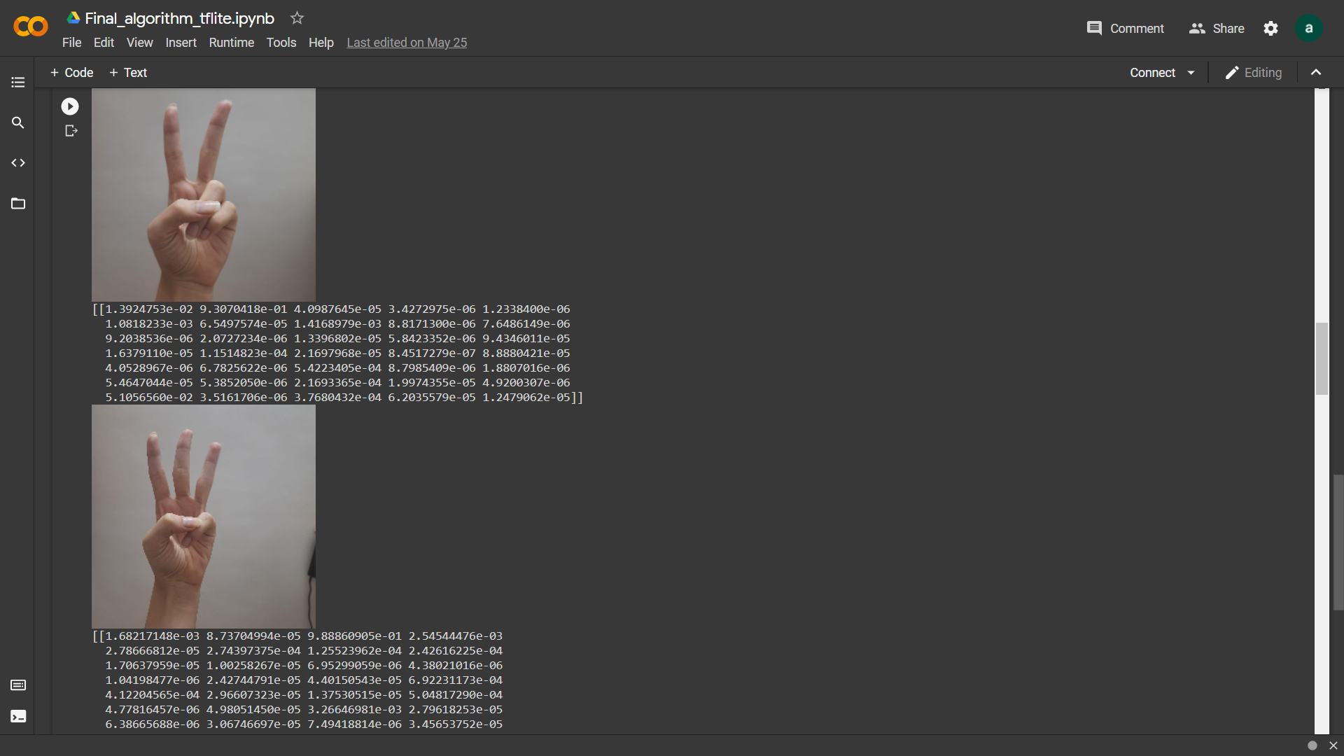
Tensorflow Lite results of final algorithm

Slide 19
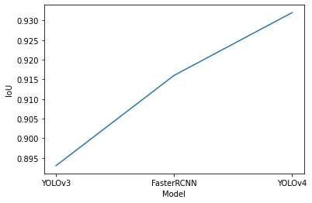
Performance Evaluation (Object Detection)
Hand Detection Method | Avg IoU | Avg Time
YOLO v4 | 0.932 | 0.0091
Faster RCNN | 0.916 | 2.128
YOLO v3 | 0.893 | 0.0189

Slide 20
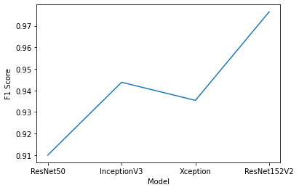
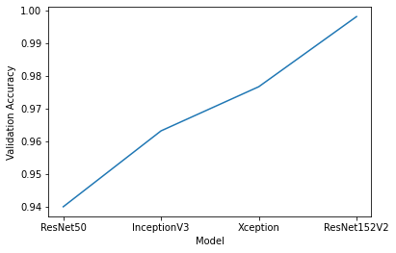
Performance Evaluation (Image Classification)
Image Classification Algorithm | Training Accuracy | Validation Accuracy | Training Loss | Validation Loss | F1 Score
ResNet152 v2 | 0.9873 | 0.9955 | 0.0468 | 0.0590 | 0.9765
Xception Net | 0.9990 | 0.8401 | 0.0140 | 0.6300 | 0.9354
Inception Net | 0.9586 | 0.9922 | 0.1410 | 0.0229 | 0.9438

Slide 21

Application

Slide 22
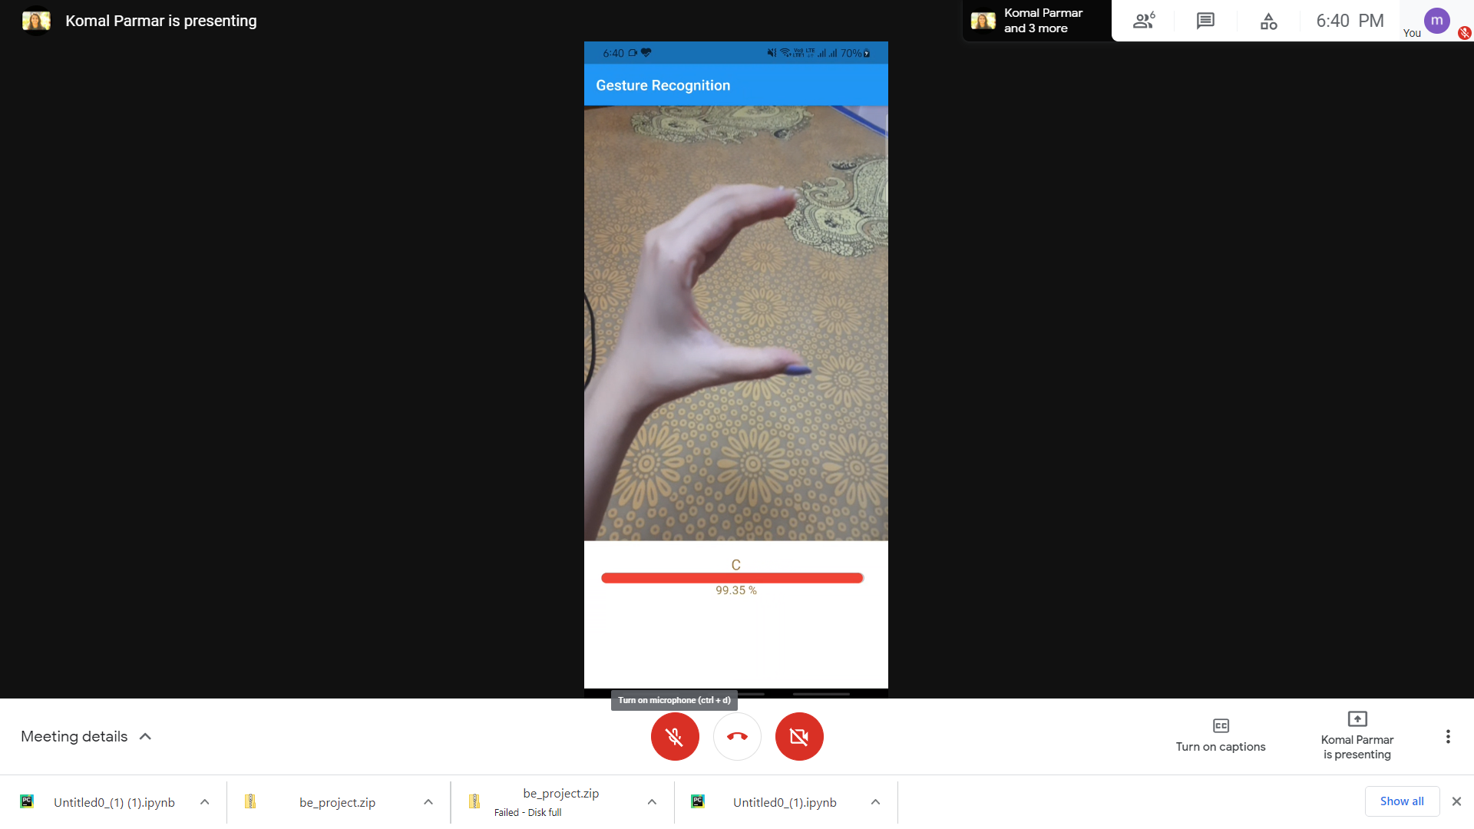
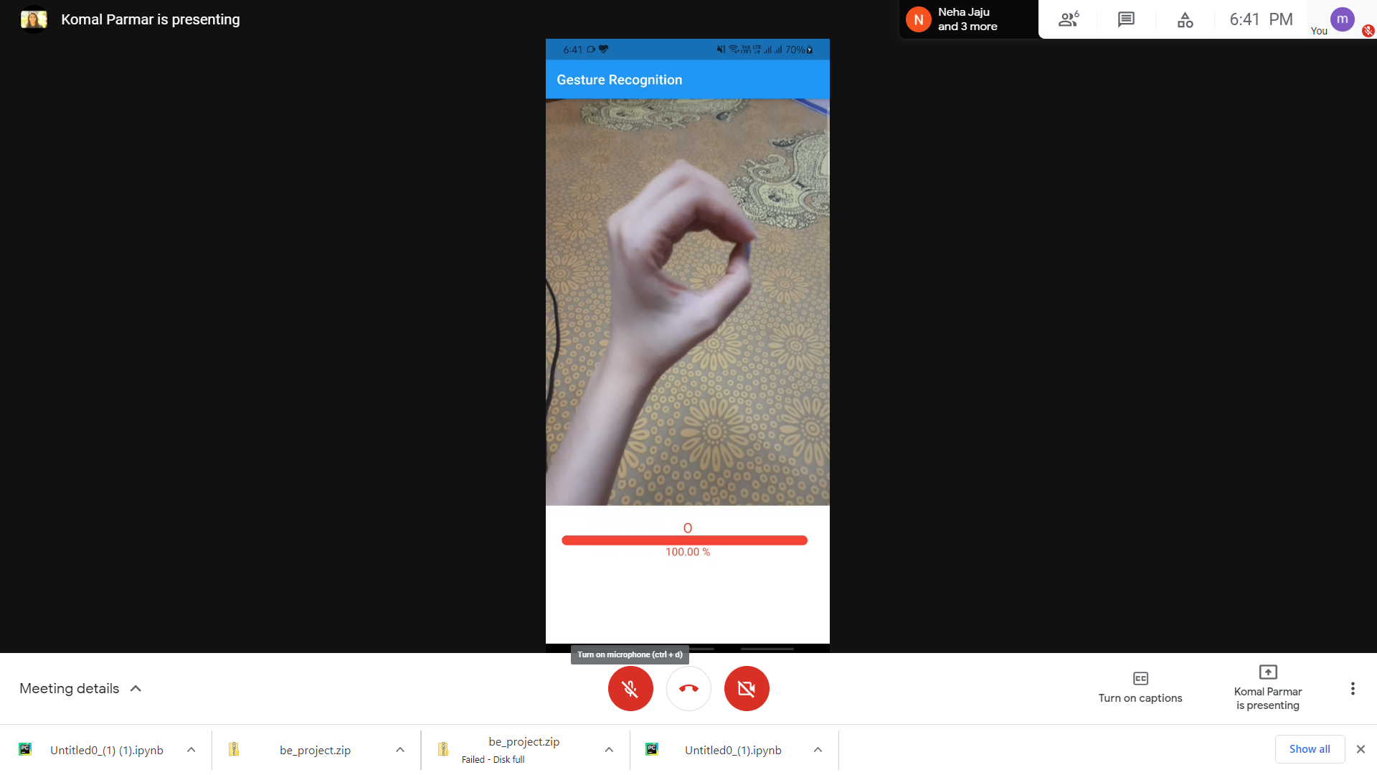
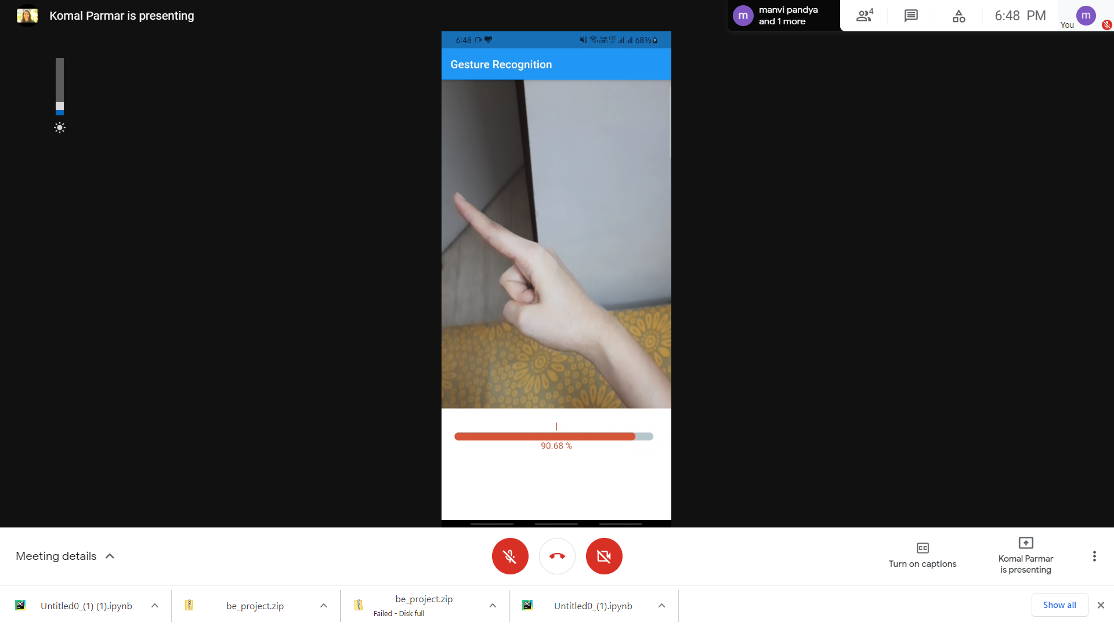
Test Cases
Single hand gesture with noise in the background

Slide 23
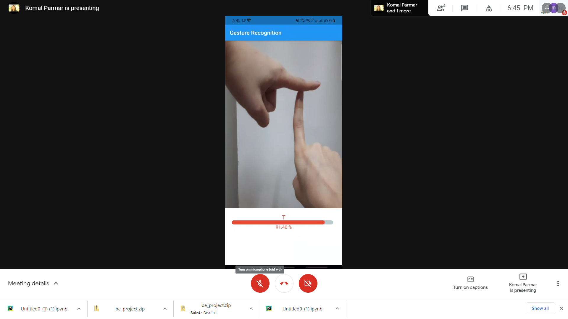
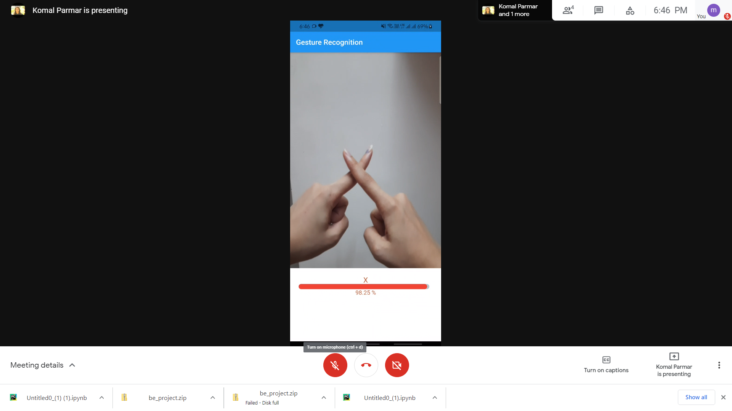
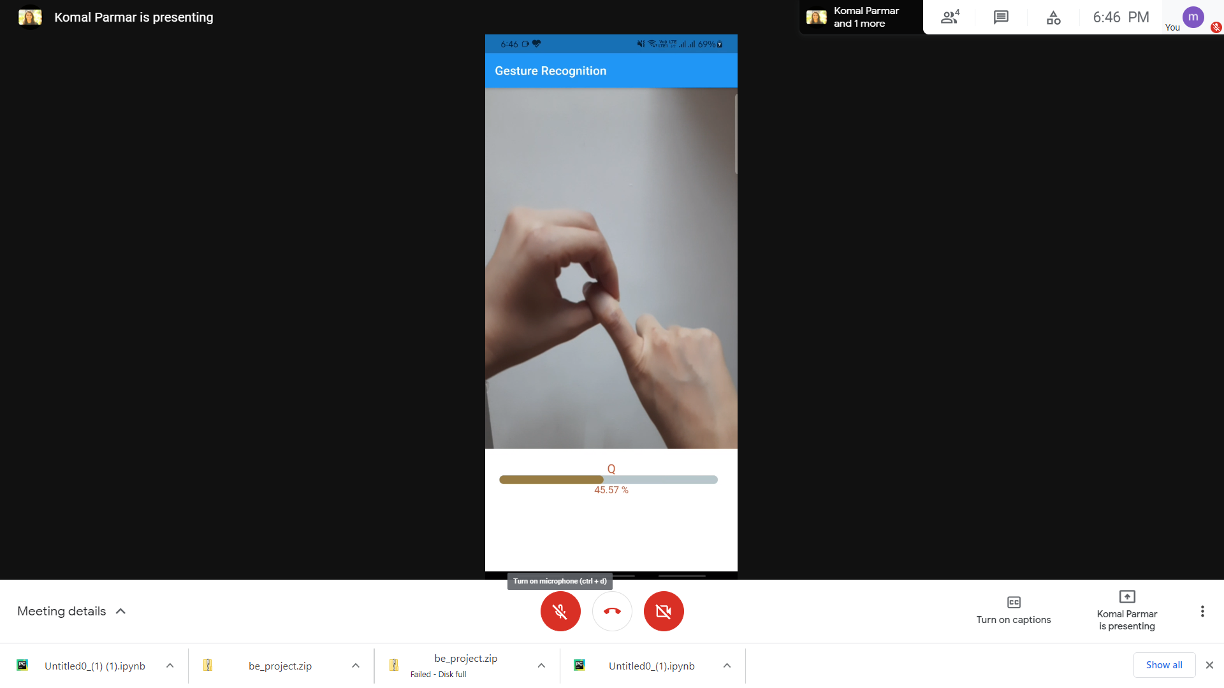
Test Cases
Single and double hand gesture with plain background

Slide 24
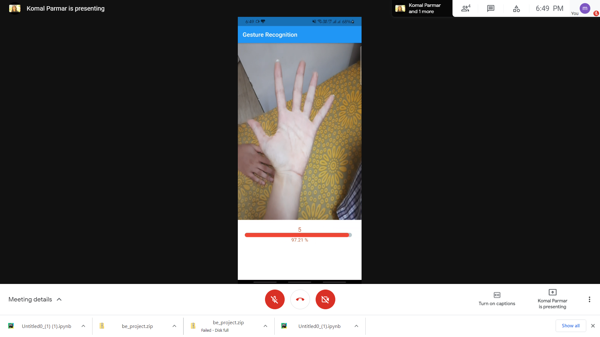
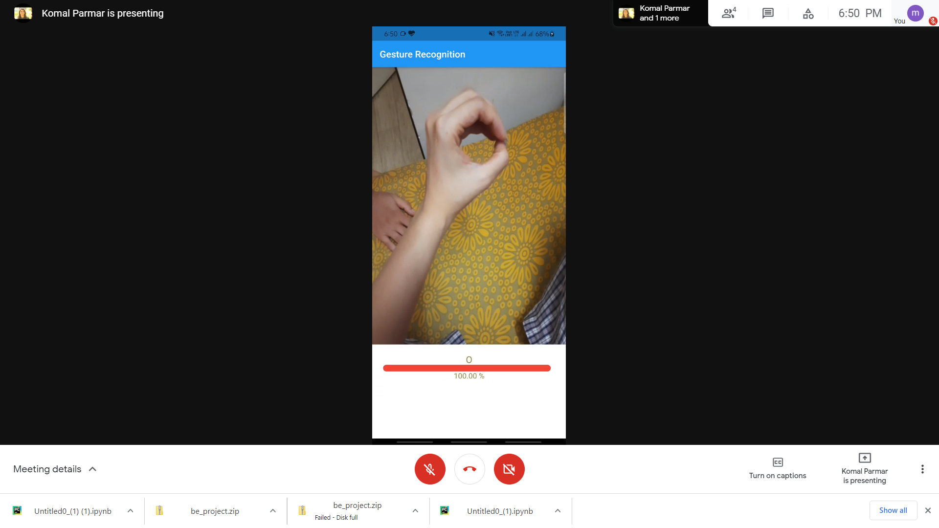
Test Cases
Hand gesture with another hand in background

Slide 25
Result Analysis and Conclusion
After evaluating various approaches we concluded that a vision-based approach for gesture recognition is better due to its efficient accuracy, cost and portability compared to other approaches. In a vision-based approach CNN works better than other classification algorithms. The application will recognize deaf-mute speech samples of alphabets (A–Z) and digits (1 to 9). Users have the flexibility to add their own customized gestures and convert speech to text. For object detection yolov4 has been implemented with average IoU and average time 0.932 and 0.0091 respectively and for image classification ResNet has been implemented with F1 score of 0.9765. After integrating yolov4 with ResNet152v2 we were able to achieve accuracy of 96.2%.

Slide 26
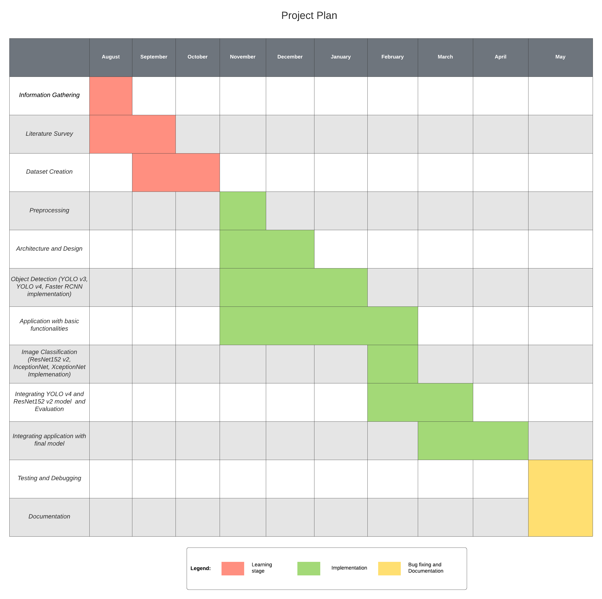

Slide 27
References
“Hand Gesture Recognisation And Voice Conversion System For Dumb People”, 5th International Conference on Advanced Computing & Communication Systems (ICACCS), 2019.
“Real-Time Sign Language Recognition Based on Video Stream”, Proceedings of the 39th Chinese Control Conference, Shenyang, China, July 27-29, 2020.
“Android based American Sign Language Recognition System with Skin Segmentation and SVM”, 9th ICCCNT, IISC, Bengaluru, India 2018.
“Real-time Conversion of Sign Language to Text and Speech”, Proceedings of the Second International Conference on Inventive Research in Computing Applications (ICIRCA), 2020.
“Implementation of Virtual Assistant with Sign Language using Deep Learning and TensorFlow”, Proceedings of the Second International Conference on Inventive Research in Computing Applications (ICIRCA), 2020.
“End-to-End Speech Translation With Transcoding by Multi-Task Learning for Distant Language Pairs”, IEEE/ACM Transactions on audio, speech, and language processing, VOL. 28, 2020.

Slide 28
Thank You!

